Slide 1
“The Clash of the EU and U.S. on Privacy & National Security”
Peter Swire
Holder Chair of Law & Ethics, Georgia Tech
Senior Counsel, Alston & Bird
ACIR, March 22, 2018

Slide 2
Overview
Swire background
Why the EU is stricter than the U.S. on how companies protect privacy
Compliance – how GDPR shifts from aspiration to enforcement
Two big questions:
  Will Europe participate in Big Data, AI, and the Internet of Things?
  Will Europe cut off transfers to the U.S. by deciding the U.S. lacks “adequate” protection due to NSA surveillance?

Slide 3

Peter Swire Background
1998 book from the Brooking Institution
on US/EU privacy disputes

Slide 4
Peter Swire Background
Law professor, first article on law of the Internet in 1993
President Clinton’s Chief Counselor for Privacy
  HIPAA, financial privacy rules
  Helped negotiate US/EU “Safe Harbor” for privacy
  Chaired WH Working Group on how to update wiretap laws for the Internet
Georgia Tech in 2013
President Obama’s Review Group on Intelligence and Communications Technology (“NSA Review Group”)

Slide 5
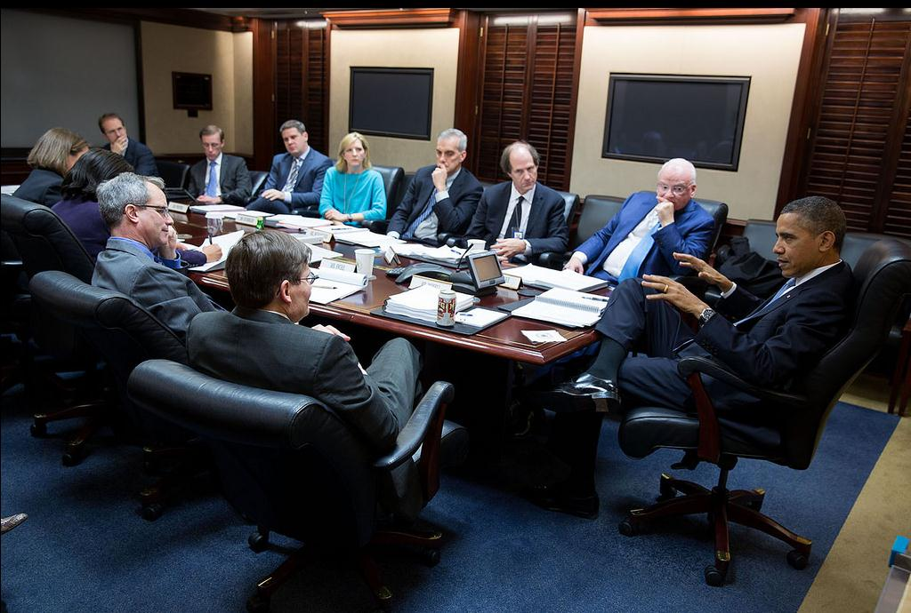
The Situation Room: December 2013

Slide 6
Alston & Bird
Senior Counsel at Alston & Bird since January 2015, counseling range of clients
Privacy and Cybersecurity Group
  Jim Harvey, David Keating, many other certified experts
  Brussels office, Jan Dhont, GDPR
Schrems v. Facebook
  Lead expert witness selected for Facebook to explain U.S. surveillance law to EU audience
  https://www.alston.com/en/resources/peter-swire-irish-high-court-case-testimony
Has served as expert witness on privacy and cybersecurity

Slide 7
A Few GDPR Requirements
Right to access and rectification
Right to be forgotten
Right to data portability
Consent in advance, has to be specific, informed, and voluntary
Data protection impact assessments on new systems
Document the legitimate basis for data processing
Any customers where data is collected in/from Europe
Fines – up to 4% of global revenue

Slide 8
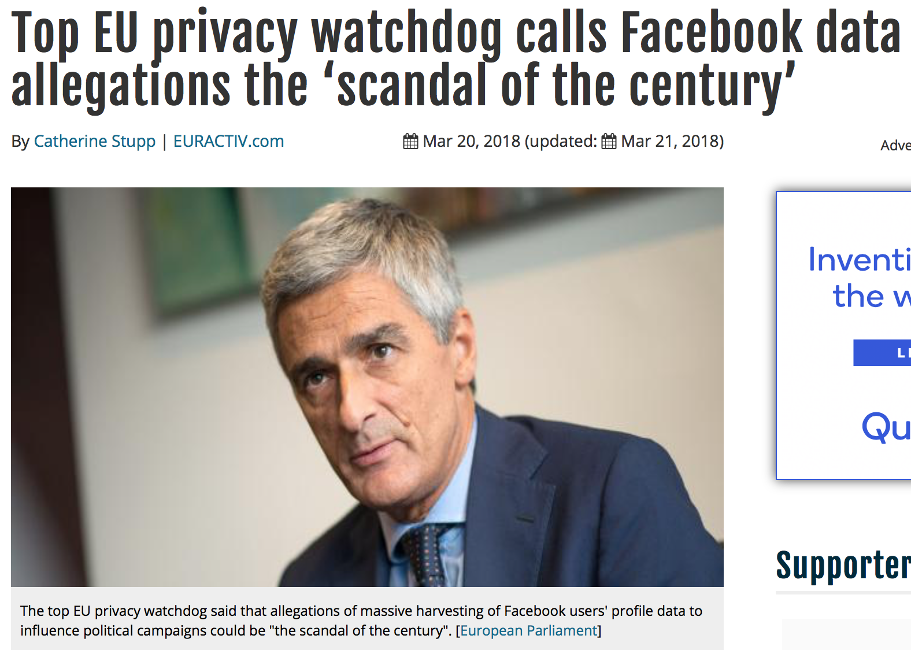
FB: “Scandal of the Century”
Sourcehttps://www.euractiv.com/section/data-protection/news/top-eu-privacy-
watchdog-calls-facebook-data-allegations-the-scandal-of-the-century/

Slide 9
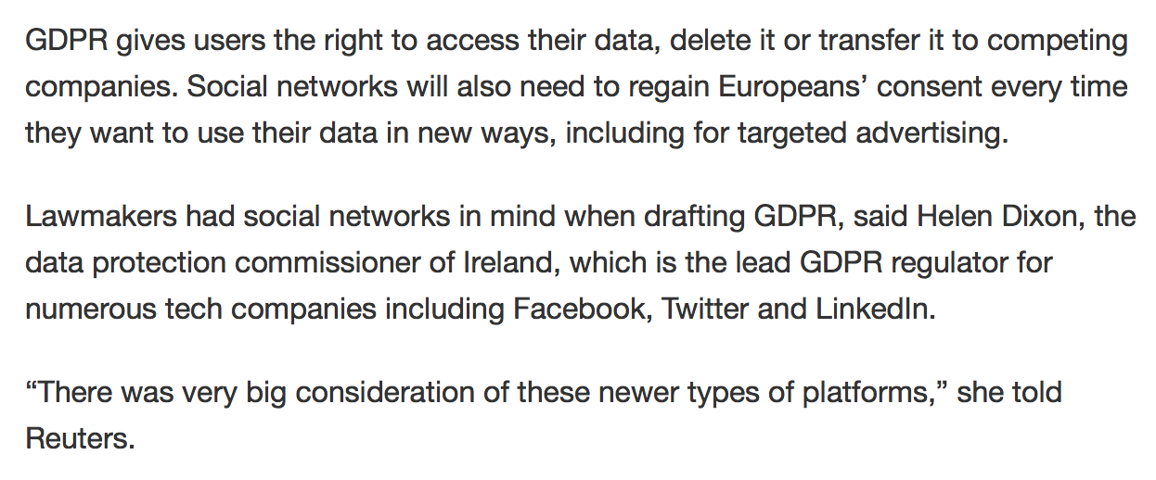
GDPR and Social Networks
Source: https://www.insurancejournal.com/news/national/2018/03/20/483866.htm

Slide 10
Part 1: Why is the EU Stricter on Privacy?
Protect the common market
Protect fundamental rights
Protectionism
EU self-determination
Business lobbying not as effective in EU

Slide 11
Protect the Common Market
OK to move data from Fiat-France to Fiat-Italy?
  France said no, because strict French privacy law
  Result – Data Protection Directive enacted 1995, in effect 1998
Reasons for the Directive
  Free flow of data in the single market, along with free flow of goods and persons (helps business)
  Protects individual privacy (helps consumers)
GDPR continues this effort
  A “regulation” sets single standard for all Member States
  Better for single market than a “directive”, with diverse national laws

Slide 12
Fundamental Rights
Treaty of Lisbon, 2009
  Strong affirmation of fundamental rights, in the EU Charter
  European Court of Justice gets direct authority to issue orders, binding on the nation states
    Similar to a holding of the US Supreme Court
    Previously, European Court of Human Rights had less direct authority, acting under the European Convention on Human Rights
ECJ has been very active in protecting fundamental rights
  Schrems 2015 struck down Safe Harbor
  Data retention laws struck down, and Canadian agreement on passenger name records
The big picture: protecting fundamental rights seen as an essential element in tying Member States more tightly together
  Protect the European project, and not simply privacy

Slide 13
Protectionism
Common allegation: the EU is being protectionist with its privacy rules
  Strict rules can advantage EU companies, and keep US competitors out
  E.g., if Germany has super-strict rules, German companies design for that by default, but US competitors don’t
Localization
  The protectionist effect is greater if EU requires that personal data be stored within the EU
  That is a more direct advantage to EU providers
My view: protectionism tendencies exist but are not as important to the big picture as some have suggested

Slide 14
EU Self-Determination
Compared to protectionism, I suggest that Member States and the EU actually are motivated more by “self determination”
Members of the EU are not as laissez faire/free market as the U.S.
  Sweden and social democrats – willing to regulate the market
  The “protective principle” for environmental law and privacy
    Don’t do the risky new thing (genetically modified organisms or Big Data) unless you are sure protections are in place
Q: how do you think Europeans feel to have their daily online life is designed by engineers in Silicon Valley?
  Have you seen the TV show “Silicon Valley”? Should those characters define the details of our daily lives?

Slide 15
Business Lobbying in US and EU
Business lobbying is not as effective in Brussels as it is in Washington
  New laws are easier to pass in the EU
In DC, business lobbying is effective
  Campaign finance
    DC: average to win a Senate seat about $12 million
    That’s about $5500 per day x 6 years x 365 days
    Do you have that many friends?
  Gridlock: it is very hard to create new laws: this week’s Omnibus may be last bill before mid-terms
    That helps businesses who don’t want privacy regulations
In Brussels, business lobbying is far less effective
  The Commission (the Executive) has lifetime employees, usually with no private-sector experience
  Their output, day in and day out, is more directives, regulations, etc.
  As of 2015, had 40,000 “legal acts” from the EU (source: http://en.euabc.com/word/2152)

Slide 16
Why is the EU Stricter on Privacy?
To recap, have strong reasons for EU strictness:
  Protect the common market
  Protect fundamental rights
  Protectionism
  EU self-determination
  Business lobbying not as effective in EU

Slide 17
Part 2: From Aspiration to Compliance
The main point: at the time of 1998 book, EU data protection was a set of aspirations
  Today, the GDPR is a set of mandates, with the potential of big fines, and requiring compliance
Anecdote #1 from 1997 research:
  I interviewed one of the (then) Big 6 accounting firms in Paris
  I asked “what do you do in your audits about privacy?”
  The answer: “We ask one question: have you filed the paperwork to register your files with the CNIL.”
  Contrast 2018: that does not sound like a modern compliance program

Slide 18
Aspirational Rules in the 1990’s
Anecdote #2: I led a U.S. mission to 7 member states in 1998 to learn the rules for individual access to data
  In each country, I asked about exceptions to the rule – unlimited in Article 12 of the Directive – for individual access
  I specifically asked whether students have a right to access the exams they took
  They all chuckled and said no
  We found literally dozens of exceptions to the access requirement, with almost none of them captured in formal text
  The data protection authorities only responded to a specific, well-founded complaint

Slide 19
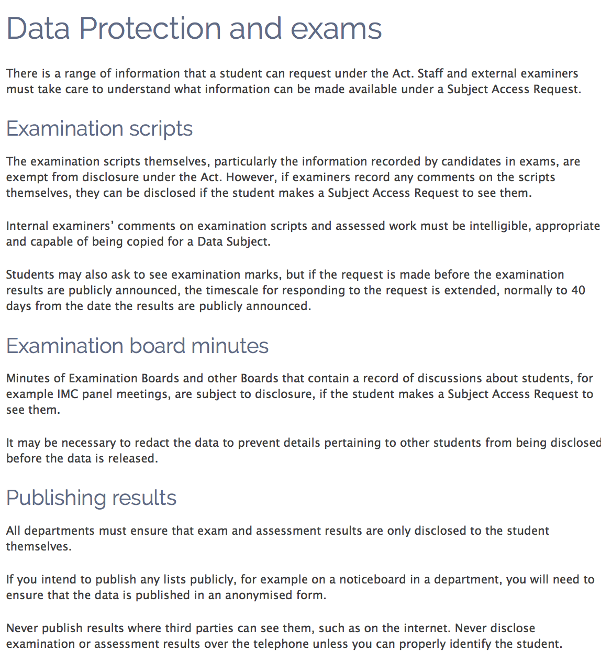
Compliance Today
Source:
http://www.bath.ac.uk/data protection/guidance/data-protection-exams/index.html

Slide 20
Aspirational Rules in the 1990’s
Anecdote #3: Heathrow Airport
  Research for 1998 in the lead-up to the 2000 US/EU Safe Harbor
  Big issue – legal to transfer personal data from EU to US?
  My hypothetical: OK for business travelers to bring their laptops from Heathrow to the US?
The dialogue:
  That got the lead EU civil servant SO annoyed: “Of course their will not be a customs station at the airport checking every laptop! We are reasonable!”
  Swire: “Can you explain where in the Directive it makes it legal to take the laptop? You say the US is not ‘adequate’ and databases are illegal to transfer”
  EU: “I already said we are reasonable” & “but of course it is illegal to take a medical database”
  Swire: “Thank you, that will be very reassuring for our General Counsel.”
The reality: everyone flew with their laptops

Slide 21
Compliance Today
The update:
  (1) Heathrow won’t be part of the EU after Brexit
  (2) Still no customs stations checking laptops at the EU airports
The compliance reality
  EU privacy/GDPR conferences and presentations are everywhere
  Fines up to 4% of global revenue
  GDPR: data protection impact assessments, Data Protection Officers, and documentation of rationale for each type of processing – the new Sarbanes Oxley for compliance
  Additional strictness from ECJ and push for fundamental rights, so the power of the privacy rules may grow a lot further
In summary on Part 2: EU data protection law was aspirational in the 1990’s; it’s a compliance regime today

Slide 22
Part 3: Two Questions
Two big questions:
  Will Europe participate in Big Data, AI, and the Internet of Things?
  Will Europe cut off transfers to the U.S. by deciding the U.S. lacks “adequate” protection, due to NSA surveillance?

Slide 23
Data Protection vs. Big Data, AI & IoT
The “Fair Information Privacy Practices” since the OECD Guidelines of 1980
GDPR Art. 5: “Principles relating to processing of personal data”
  Collection limit: “collected for specified, explicit, and legitimate purposes”
  Purpose specification: “not further processed in a manner that is incompatible with those purposes
  Data minimization: “adequate, relevant and limited to what is necessary in relation to the purposes for which they are processed”
Big Data: Volume, Velocity, Variety:
  Is collection for the specified purpose? When you collected that data, and got consent, did you say “and used again and again for data analytics”?
  Even if collected for one purpose (email list; Web logs) and repurposed in your Big Data lake?
  How does “data minimization” fit with volume, and the idea of “collect everything”?

Slide 24
Big Data and Re-Identification
GDPR Art. 5: “kept in a form which permits identification of data subjects for no longer than is necessary for the purposes for which the personal data are processed”
However, Big Data threatens the ability to anonymize, or de-identify, data
Famous early Sweeney re-identification study:
  100,000 people in a zip code; publicly available data only on gender and date of birth; could uniquely identify the Governor in the database
Big Data exponentially increases the risk of re-identification
  With 100 or 1000 or 10,000 data points on an individual, the GDPR risk is that the ability to re-identify is permanent

Slide 25
Will GDPR Really Prohibit Big Data?
My view: the EU faces a major choice in how much to allow re-purposing of data to fuel Big Data analytics
  A coming battle between Data Protection Authorities and EU’s supporters of a digital single market
EU competitive position:
  GDPR compliance leads to caution or limits on Big Data experimentation
  China, US much more likely to allow cutting-edge experimentation
    These countries will get first-mover advantages for analytics
Artificial intelligence & machine learning
  The same analysis as for Big Data – stricter data limits in EU than elsewhere

Slide 26
EU and the Internet of Things
GDPR Art. 7: “Where processing is based on consent, the controller shall be able to demonstrate that the data subject has consented to processing of his or her personal data.”
Definition of the Internet of Things:
  A sensor (camera, microphone, thermometer, etc.)
  Connected to the Internet
For smart home, smart retailer, street surveillance:
  How give notice?
  How get consent?

Slide 27
Legitimate Interest as the Answer?
GDPR Art. 6: processing is lawful if:
  “processing is necessary for the purposes of the legitimate interests pursued by the controller or by a third party, except where such interests are overridden by the interests or fundamental rights and freedoms of the data subject.”
In considering compliance, example of today’s common technology of a retailer tracking a customer’s Bluetooth device in the store:
  Get (big) data about where customers spend their time in the store
  It is an IoT system, because the store’s sensors track where each Bluetooth device goes
Can you give notice and get consent to the customers? How?
Is it a legitimate interest for the store to learn what its customers like and where they walk in the store? What if this is for security purposes, too?
Are such interests “overridden” by the data subject’s rights?
Conclusion 3A: open question when Big Data, AI, and IoT are legal under GDPR

Slide 28
Question 3B: Will the EU Create the Great Firewall of Europe?
2000: Safe Harbor agreement
October 2015: European Court of Justice strikes down Safe Harbor in Schrems decision
  One concern – strict enough commercial privacy rules
  Major concern -- scope of US surveillance activities; may not be “adequate” if NSA and other surveillance takes place once the data gets to the US
December 2015: Swire testimony about safeguards and reforms in US surveillance law
July 2016: final approval of EU/US Privacy Shield to replace Safe Harbor

Slide 29
Privacy Shield
The hope with Privacy Shield:
  Creates a legal basis for data transfers, post-Safe Harbor
  Shows political will in EU and US for a strong relationship
  Manageable, stricter commercial privacy rules
  Some US government statements about legal limits on “bulk” surveillance

Slide 30
The Legal Challenges
European Court of Justice in Schrems did not (quite) find that US surveillance made transfers “inadequate”
  It did strike down Safe Harbor, expressing detailed concerns that NSA surveillance is so pervasive that EU citizens’ data cannot be safe in the US
Current Schrems v. Facebook case:
  Current challenge in Ireland to “standard contract clauses” that are used as lawful basis to send data to US and elsewhere
  Irish privacy commissioner – SCCs seem as legally weak as Safe Harbor
  Five-week trial, I testified two full days on US law governing foreign intelligence surveillance and legal protections
  Irish judge: agreed with the privacy commissioner, and will refer to the ECJ

Slide 31
What if the ECJ Rules the US is Not Adequate?
If ECJ says SCCs are illegal, no good way to over-rule that
  Binding legal effect of ECJ decision
  No mechanism for constitutional amendment
  Would require change to Lisbon Treaty
What will happen?
  ECJ decision likely in 2019
  Result is unclear
  If the court remains strict, may need large data separation between EU and US operations
  Companies should consider that possibility in establishing EU systems

Slide 32
Conclusion: The Big Picture on GDPR
Why the EU is stricter than the U.S. on how companies protect privacy
Compliance – how GDPR shifts from aspiration to enforcement
Two big questions:
  Will Europe participate in Big Data, AI, and the Internet of Things?
  Will Europe cut off transfers to the U.S. by deciding the U.S. lacks “adequate” protection?
This is a big compliance challenge, and a big risk to international trade, intelligence sharing with our allies, and the international system
These are big questions that we all face
Thank you

