Slide 1
The Economics of Cybersecurity: Breach & Liability Rules
Peter Swire
Holder Chair of Law & Ethics
Atlanta Federal Reserve
March 21, 2018

Slide 2
Overview
Swire background
Cybersecurity: the economics of breach & liability rules
Torts and efficiency rule for negligent harm to others
Economics of data breach
Tort liability for defects in software
FTC enforcement for unfairly bad computer systems
Some reasons for optimism
But, for Internet of Things, more reason for pessimism

Slide 3
Peter Swire Background
As law professor, taught Banking Regulation (1990’s), switched to Internet law (1993)
President Clinton’s Chief Counselor for Privacy
WH coordinator HIPAA medical privacy rule
WH representative for GLBA privacy rules
Law of cybersecurity (2003)
National Economic Council (2009-10) – Larry Summers, Raphael Bostic
President Obama’s NSA Review Group (2013)
Georgia Tech (2013)
Scheller College of Business; Computing, Public Policy
Institute for Information Security & Privacy
Senior Counsel, Alston & Bird

Slide 4
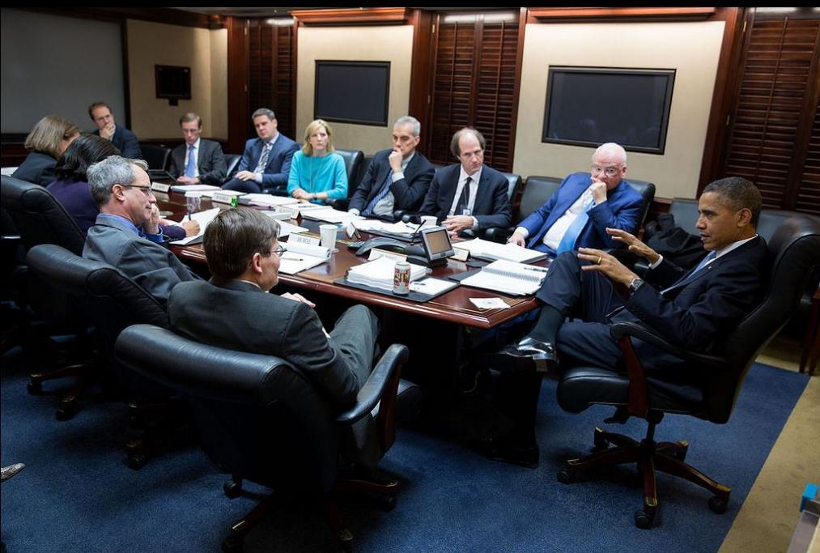
December 2013: The Situation Room

Slide 5
Part I: Efficiency, Negligence, and Torts
Economics of tort law
Negligence and the Hand test
1947 Carroll Towing case, Judge Learned Hand
Breach of duty of care if PL>B, where
(Probability of loss) * (magnitude of Loss) > Burden
Example: 10% chance of $1 million loss, so negligent if spend less than $100,000 to prevent the harm
Posner: efficient to make defendant pay if flunks the Hand test

Slide 6
Economic arguments for more or less liability than the Hand test
More liability:
Calabresi: Products liability, where manufacturers have knowledge & control the risk
Strict liability for “defects” because the manufacturer is the “least cost avoider” of the risk and consumers can’t protect themselves from defectively-made automobiles
Less liability:
Tort reform proponents such as Peter Huber
Institutional inefficiencies > theoretical efficiencies
E.g., class actions, runaway juries, biased expert witnesses
Conclusion: less liability than the Hand test because the system overly punishes the defendants, make goods more expensive, and punishes innovation

Slide 7
For Today’s Discussion on Economics of Cybersecurity
Scope: software flaws and badly protected computer systems
Assess using the Hand test – are cost-effective precautions being taken?
For Calabresi approach: to date, these have not been doctrinally treated by the law as ”products” liability, with strict liability – these are “services”
For Huber approach: I believe at least some of the tort reformer critiques are over-stated, with consequent risk of too few protections

Slide 8
Part II: Data Breaches and Market Failure
Basic idea: mis-aligned incentives for the company that holds a large database of information about consumers
Hand test: should prevent if (probability) * (magnitude of loss) > burden of precaution
For the consumers, large potential loss (identity theft, theft from bank accounts)
For the company itself, little direct harm and take few precautions, especially if consumers don’t learn about the breach
Result is market failure, where socially optimal level of precaution is higher than the company’s optimal level of precaution

Slide 9
The Tort System and Data Breaches
To date, the U.S. tort system has often prevented consumers from suing for breach:
Courts have been reluctant to make defendants pay for non-economic injury (fear of identity theft)
Courts have been reluctant to certify class actions, saying the facts vary too much among the individual claimants
Courts have been more positive, though, for bank plaintiffs, who can sue for the actual costs of replacing credit cards.
Economic analysis: tort claims alone create inefficiently low level of precautions, because companies don’t have incentives to take precautions to protect consumers

Slide 10
Data Breach Laws May Help with Efficiency
Data breach laws started in California about 2003, now in almost every state: mail notices of breach, where SSN or other key data is lost
Critique about notices mailed to individuals
Notice mailed to individuals if a breach, but individuals don’t know how to react to these notices
On more positive note:
Notices prevent companies from hiding the breach; improve market pressures for the company to take efficient precautions to protect its brand
Costs of mailing ~ cost of paying tort liability for lack of precaution
Organizational pressure for better cybersecurity
C-suite becomes aware of data breach
Increases cybersecurity precautions/budget so it doesn’t happen again

Slide 11
(2) Tort Liability for Defective Software
Part I:
Data breaches (vulnerable systems) have not been solved by tort law
Partial adjustment to get efficiency with breach notification laws
What about liability for defective software?
To date, major barriers to plaintiffs who claim insufficient precautions in the creation of software

Slide 12
Software liability and barriers to plaintiffs under tort law
Elements of tort claim: duty, breach, causation, damages
Duty: terms of service say no duty for harms caused by software
Courts have not invalidated these TOS, so no duty
Breach: did software company use reasonable care (take reasonable precautions) in writing software?
Even well-written software has numerous flaws – the mere fact of a flaw does not show lack of reasonable precautions

Slide 13
Barriers to tort liability for software
Causation:
Intervening acts of third parties – the hackers’ criminal act caused the crime, not the software
Lack of proximate cause for worldwide software problems
Appropriate for 400 million Windows 10 users to sue for a small flaw in one line of software?
If a negligent fire burns down the city of Chicago, don’t hold the slightly negligent person liable for all of that
Damages:
Economic loss doctrine – tort claims usually require physical or other physical injury, and not “mere” economic loss
Economic loss covered by contract law and warranties

Slide 14
When torts will succeed for bad software
My view is that software providers will start to lose when physical injuries occur, such as when an autonomous vehicle hits a pedestrian
Terms of service – the pedestrian did not agree to those
Breach – looks like a defect under products liability (car) rather than a negligent service
Causation:
No intervening hacker/criminal
Proximate cause is easier: 1 person hit by car, not 400 million software users
Damages: physical injury rather than mere economic loss

Slide 15
Part 3: FTC and unfair/unreasonable security practices
To recap:
Likely to have inefficiently low precautions in computer systems of barriers to tort claims for data breaches
Likely to have inefficiently low precautions because difficult to sue for defective software
Federal Trade Commission Act, Section 5, with many cases claiming “unfair and deceptive trade practices”
Wyndham Hotels case: FTC claimed: data stored in plain text (unencrypted); no firewall; weak passwords; and failure to remedy known security flaws
Case settled with 20-year comprehensive cybersecurity plan for the company

Slide 16
Does FTC Sec. 5 Improve Efficiency in Cybersecurity?
Pro: tort system leads to inefficiently low precautions for systems (data breach) and software, so increase precautions using Sec. 5
Con: National Technology Security Coalition is Chief Information Security Officer (CISO) policy group, HQ in Atlanta
Concerns that standards under Section 5 are vague, and enforcement is unpredictable by the FTC
Programmers don’t know how to code for “fair” or “unfair” practices
Possible path forward: for technically complex areas, reduce uncertainty by pointing to standards/norms
NIST Cybersecurity Framework, PCI-DSS, and other standards are becoming much more widely adopted, with greater specificity than previously for “good practices”

Slide 17
Conclusion – Part 1
Reasons to believe we are getting inefficiently low precautions for cybersecurity
Some reasons for optimism:
Data breach laws help address weaknesses in computer systems
Market forces have pushed some software toward better cybersecurity
FTC (and state law) “unfair and deceptive” laws, when they incorporate standards, may push large system owners toward efficient precautions

Slide 18
Coda: Internet of Things Cybersecurity
Pessimism for Internet of Things
Billions of devices in coming years
Few incentives for security in $25 or $250 consumer device where consumers have little ability to gauge cybersecurity
When have flaws, little or no patching
When the manufacturer goes out of business, no customer support
Here is what the graph looks like --

Slide 19
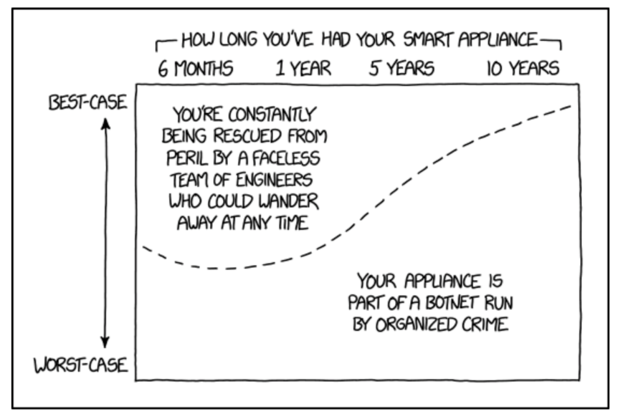

Slide 20
Efficient solutions for IoT?
For this emerging challenge, currently have big reasons for pessimism
Big corporations can develop procurement and management policies to mitigate the risk from IoT
For consumers, be more cautious in using smart devices than most people have realized yet
Goal is to speed up the societal learning curve of how to do cybersecurity in a world of pervasive, connected devices
My apologies for ending on this pessimistic note, but these conclusions on IoT are widely shared among security researchers so we should focus more attention there
Thank you

