Slide 1
IAPP KnowledgeNet Los Angeles “Thinking Outside the Cookie Jar”
The Second Wave of Global Privacy Protection:
Why This Year Is Different
Peter Swire, Senior Counsel, Alston & Bird
Huang Professor of Law and Ethics
Georgia Tech Scheller College of Business
April 29, 2015

Slide 2
Overview
First Wave of Global Privacy Protection – 1990’s
Post 9/11
Second Wave
Responses from post 9/11 period do not handle the risks and realities in privacy and cyber today

Slide 3
First Wave
1993 – commercial activity on Internet
The First Wave
EU Directive in effect (1998); Safe Harbor (2000)
HIPAA (rules 1999-2000)
GLBA (law 1999)
Children’s Online Privacy Protection Act (1998)
Privacy policies and FTC rise to prominence for Internet privacy

Slide 4
Post 9/11 – Privacy slowdown
Security vs. privacy
Connect the dots
From “need to know” to “need to share”
Patriot Act 2001 (compare to 2000 proposal)
PNRs as US/EU focus – sharing more data
Self-regulatory efforts decline
FTC focus on “harm” only
Corporate focus primarily on the privacy policy

Slide 5
Post-9/11 (continued)
Meanwhile
Institutionalization of the CPO role
Safe Harbor adoption
While US did little
Canada, Mexico & steady stream of others led to over 100 countries with comprehensive laws by 2012 …

Slide 6
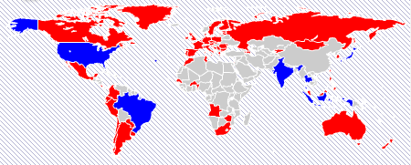
2012 Privacy Laws
Comprehensive Law
Sectoral Law

Slide 7
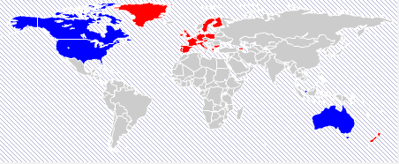
Compare 2012 with 1998 Privacy Laws
Comprehensive Law
Sectoral Law

Slide 8
The Second Wave: Public Attention to Privacy and Cyber
Like the 90’s, press stories very prominent on privacy and cyber
See the IAPP Daily Dashboard – it’s long every day (11)
Press and private sector
WSJ and “what they know” series
Growth industry for privacy, data breach, cyber reporters

Slide 9
The Second Wave – New Technologies
Social networks
Facebook not open to the public til 2006
Mobile and smartphones
Location; new customer data for many
Online behavioral advertising
Huge slump after dot.com crash
Today, central to many business strategies
Cloud
Government access (Snowden)
Cyber-security/encryption/information sharing

Slide 10
EU as a Driver (Again)
Coming soon: General EU Data Protection Regulation
Right to be Forgotten
2% of global revenues
Expanded jurisdiction
Expanding DPA enforcement/activity
Coming changes to Safe Harbor
And, it’s not just the EU
Global companies need a global strategy

Slide 11
Second Wave: The Snowden Effect
Press and government surveillance (Snowden)
Creates atmosphere for possible change
Competitive issue for US companies abroad
One response was President Obama’s Review Group on Intelligence & Communications Technology
46 recommendations in 300 page report
Surprisingly many have been adopted
USA Freedom Act introduced yesterday by bipartisan group in Senate would do more

Slide 12
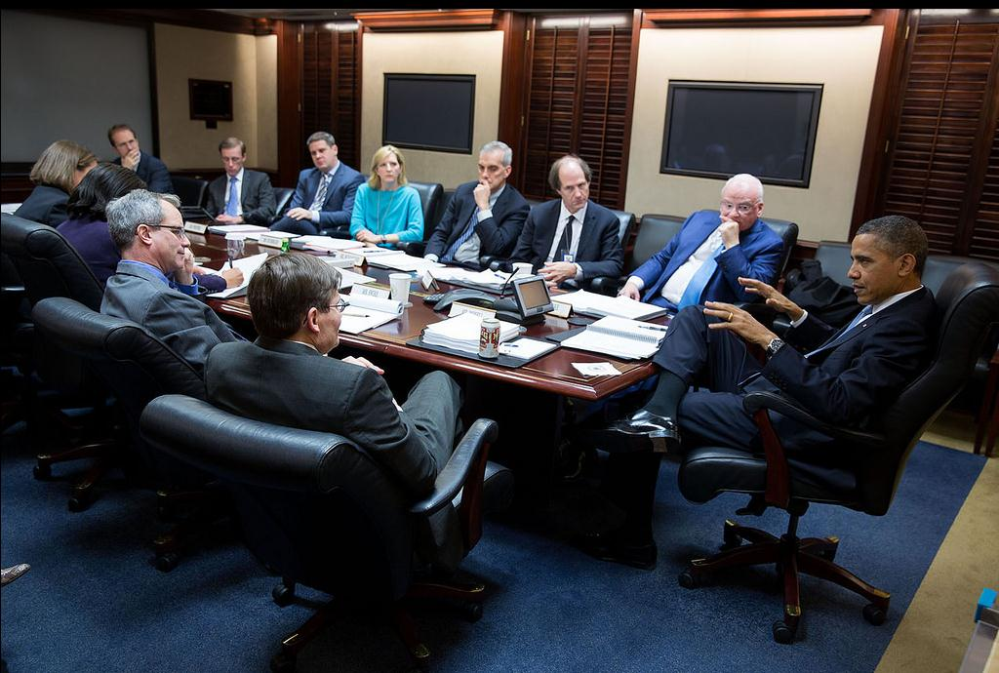
December 2013: The Situation Room

Slide 13
Second Wave: US Government Activity
Obama administration
Information sharing bills just passed the House
Data breach being seriously considered this year
New bill language for Consumer Privacy Bill of Rights
Student privacy (K-12): bipartisan
FTC: far beyond 2005 view of “harm”
Consent decrees in privacy: “comprehensive” programs
So many issues/workshops: OBA/DNT, Big Data (discrimination), IoT, data brokers, cross-device tracking
Cyber security (along with many other federal agencies)
Congress
Info sharing, data breach, drones, IoT, Big Data, wearable health devices, FISA, ECPA …

Slide 14
Second Wave: The Private Sector
Self-regulation is back
Student privacy; online advertising; smart grid; mobile notices; beacons and retailers; connected cars; drones; IoT
CPO – far beyond drafting privacy policy & compliance
Benefits of data – monetization strategy
Cyber – big data and risk of big data breach
Your company’s data strategy
Compliance with current rules
Compliance with what is coming
Insight about where to position your company
Ethics, training beyond compliance

Slide 15
Conclusion
A lot happened in the first wave of global privacy protection
With 9/11, less privacy change
But the second wave is on us now
Organizations need a strategy to manage their data for business goals, consistent with both privacy and security

