Slide 1

“What Digital Sovereignty and the Decline of Globalization Means for US Companies”
Alston & Bird LLP, Spring IAPP Lunch, March 30, 2026

Slide 2
Overview
Mapping the rise of globalization since 1989 and 2001
Globalization on the Internet, now declining
Multiple U.S. actions to limit globalization, also in China and the EU
Lessons from the Japanese and U.S. auto industry
Next steps for U.S. and global companies
Two helpful sources
Edward Fishman, “Chokepoints: American Power in the Age of Economic Warfare”
Peter Harrell, “Has the U.S. Reached ‘Peak Sanctions’?”

Slide 3
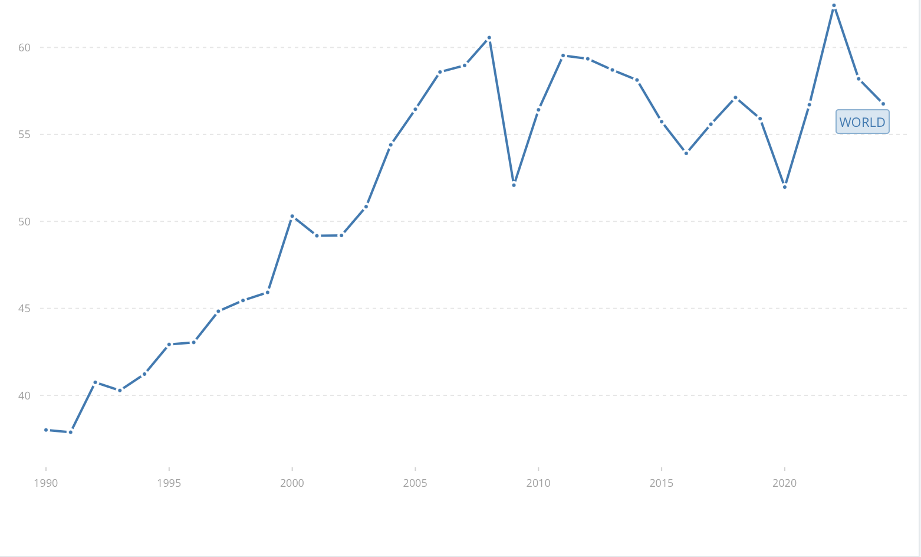
Globalization: Trade as % of GDP (World Bank statistics)
1990: 38%
2008: 61% (economic crisis)
2022: 62%
2024: 57% (more tariffs in 2025)
------------------------------------
Berlin Wall fell 1989
China entered WTO 2001
Lots of trading between former adversaries (theme of Fishman’s “Chokepoints”)
Supply chains and services went global
Now, geopolitical risk again from relying on other nations

Slide 4
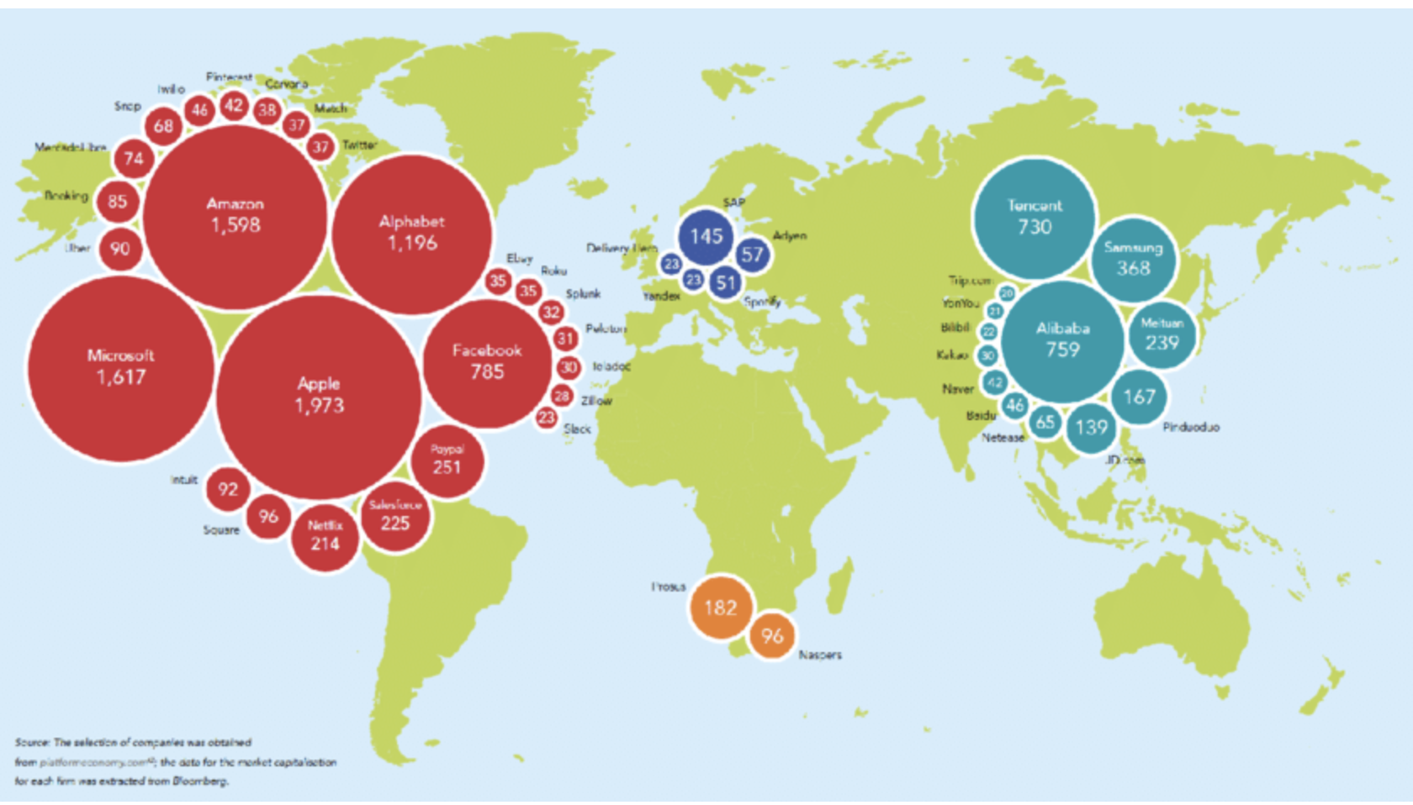
(De-) Globalization and the Internet
1993 John Gilmore (a founder of EFF): “The Internet treats censorship as damage, and routes around it”
U.S. policy 1990’s to 2024: “Free flow of data on the Internet”
Chart: Market cap of leading tech firms (Dec. 2020), with U.S. leadership
==
De-Globalization
China: “Indigenous Innovation”/”Made in China 2025”
EU: “Digital Sovereignty” and fear of the “Kill Switch”: (1) The Hague; (2) Breton (but, see Christakis on K.S.)
US: (1) Protecting Americans’ Data from Foreign Adversaries Act (PADFA); (2) DOJ Bulk Data Rule
https://www.researchgate.net/figure/Big-Tech-market-capitalization-above-US-20-billion-in-December-2020-Source-SOMO_fig1_353050626

Slide 5
U.S. Measures to Limit Risk from China/Adversary Nations
PADFA (2024) and Bulk Data Rule – limit sensitive data exports
AI infrastructure – deny high end to Chinese users
Connected Cars – no data to China
Ports/cranes – don’t buy Chinese and risk the ports
Subsidies for rare earths
Harrell on “Peak Sanctions”: by 2023, 3X number of sanctions from 2013
Swire & Sacks, “Personal Data as a Dual-Use Technology: Critically Assessing the New Alliance of Privacy and National Security”, Virginia Journal of International Law (2026)
Swire, “Personal data as a dual-use technology: Privacy professionals face new export controls” IAPP
Today, panel at 3:30: “National Security Is Screwing Up My Privacy Program”

Slide 6
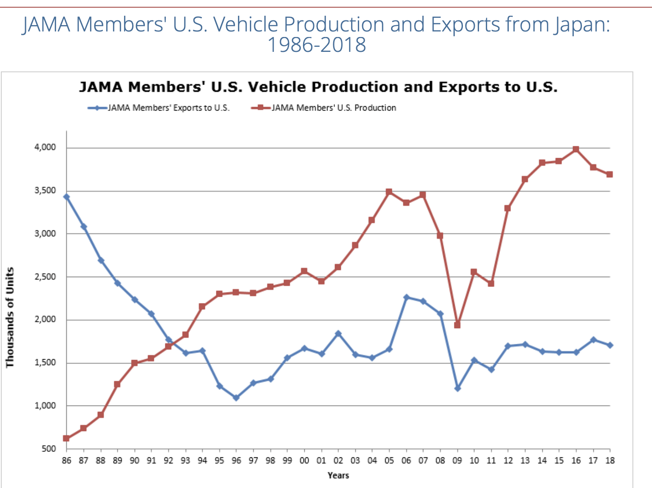
“Foreign” Cars Became “Domestic”
Global companies can consider how to be and seem “local”
Japanese car company sales:
1986: 3.5 million cars imported, 0.6 million build in U.S.
2018: 1.7 million cars imported, 3.7 million built in U.S.
Japanese & Korean car companies: estimated 90,000 U.S. jobs directly from U.S. manufacturing
For U.S./global companies today:
Develop a long-term strategy for “feeling” local
With AI and instant translation, can “localize” in addition to “personalize”
https://www.jama.org/00-japan-industry-auto-data-trends/

Slide 7
Conclusion: Some Next Steps for U.S./Global Companies
Hedge with local corporate and personnel structure
Japanese and Korean auto strategy to be/seem “local”
Manage your geopolitical risk
“Data governance” already has privacy, cybersecurity, AI
Add national security expertise to manage geopolitical risk – we’re doing that more at CBDF
Synergies from managing privacy and national security
Data inventory – any “bulk data” or PADFA-sensitive data going to China?
“Know your data” – tag data by nation, sector, etc.
New sanctions and digital sovereignty requirements will keep emerging
Manage your supply chain & contracts – what risk of forbidden or high-risk counter-parties?
Finally, the “good old days” of full globalization won’t come back
You’ve heard about the decline of the “rules-based international order”
Prepare to do business in a world of digital sovereignty and de-globalization, and you will be ready for the changes

