Slide 1

“Cybersecurity, AI, and Data Sovereignty: Cooperation and Clashes Between the EU and the U.S.”
Peter Swire
JZ Liang Chair, College of Computing, Georgia Tech
GT Entrepreneurs Network
Brussels
November 17, 2025

Slide 2
Overview
Background on Swire and the GT School of Cybersecurity and Privacy
Cloud sovereignty – relying on foreign cloud providers
Cybersecurity and sovereignty – risks if personal data is NOT shared across regions
AI and sovereignty
Some thoughts for tech-savvy entrepreneurs

Slide 3
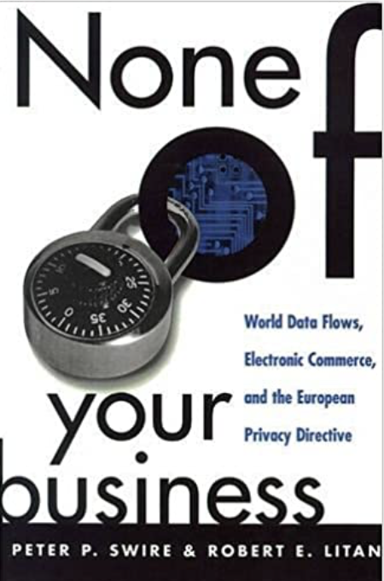
Swire background on EU
1980-81, Institut d’Études Europénnes, Brussels
1998 Brookings book on EU/U.S. data privacy
OMB Chief Counselor for Privacy, 1999-2001
After Snowden, NSA Review Group
Testified in Irish Schrems II trial on U.S. intelligence law
Cross-Border Data Forum

Slide 4


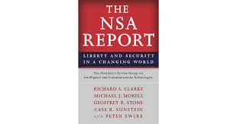

Government Service
Chief Counselor for Privacy, 1999-2001
Special Asst. to President Obama for Economic Policy, 2009-2010
NSA Review Group, 2013
Forum on Cyber Resilience, 2015-21
Future of Encryption, 2020-22

Slide 5
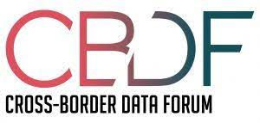
Georgia Tech, 2013 - present
JZ Liang Chair, GT School of Cybersecurity and Privacy
Professor of Law & Ethics, GT Scheller College of Business
After 2013, created “Georgia Tech Cross-Borders Request for Data Project”
Funding Hewlett Foundation, Carnegie
Founder and Research Director (2018 - )

Slide 6
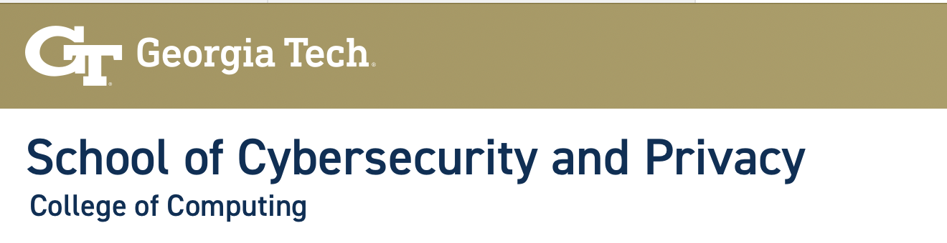
Our Mission:
SCP works to create security for everyone and everything, everyday.
We ...
Value multidisciplinary work,
Draw inspiration from applications,
Believe security is fundamental to computing.
“The school’s work is both interdisciplinary and multidisciplinary.
Many current faculty have joint appointments with other schools in the College of Computing, as well as with the School of Electrical and Computer Engineering, the Scheller College of Business, the School of Public Policy, and the Sam Nunn School of International Affairs,

Slide 7
This fall at SCP, as examples:
SCP Faculty Finds Bedrock of Network Security Vulnerable to Physical Attacks
SCP Researchers in Wired: Tile Tracking Tags Can Be Exploited by Tech-Savvy Stalkers
Georgia Tech Leads the Way – Again – at Premier Global Hacking Competition (Defcon)
Professor Jon Lindsay's New Book: Age of Deception
From Sleepless Nights to Global Champions: How Team Atlanta Conquered the AI Cyber Challenge ($4 million DARPA prize)
Saltaformaggio in The Register: A shot in the dark: Can malware vaccines stop ransomware's rampage?

Slide 8
Digital Sovereignty
Traditional sovereignty
Territorial control
Digital sovereignty
Highly interconnected world
Globalization since rise of Internet in the 1990’s
But, risks to sovereignty (to EU, to U.S.) from hardware, software, or data

Slide 9
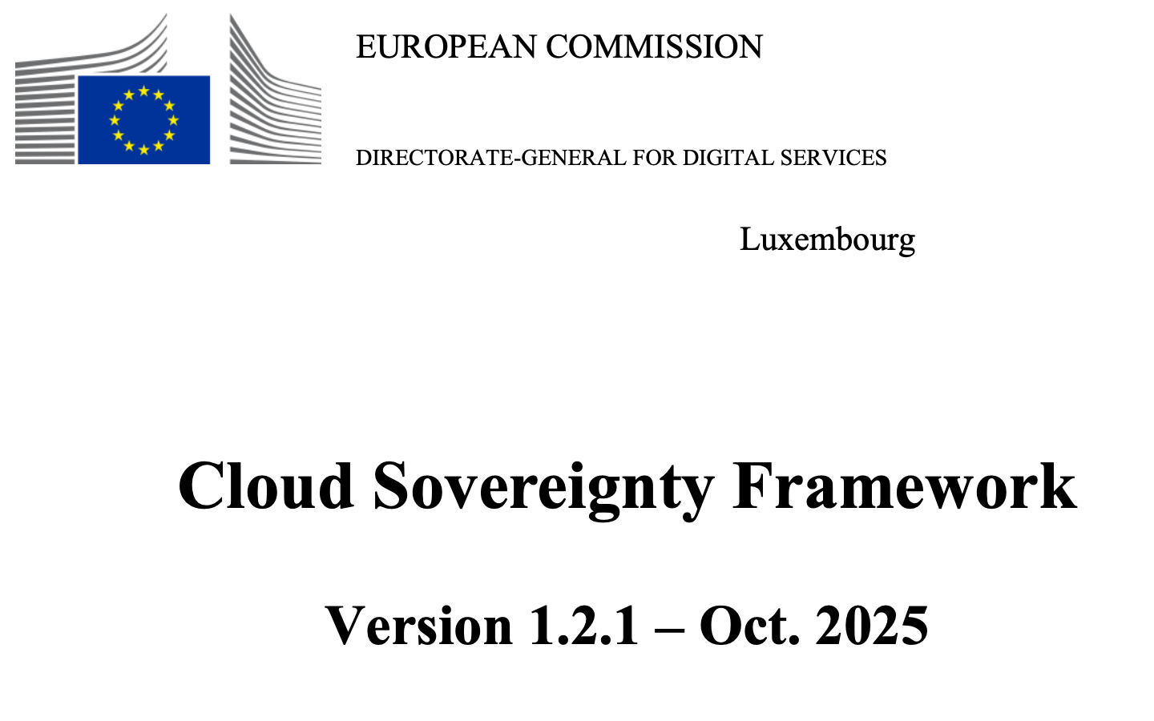

Slide 10
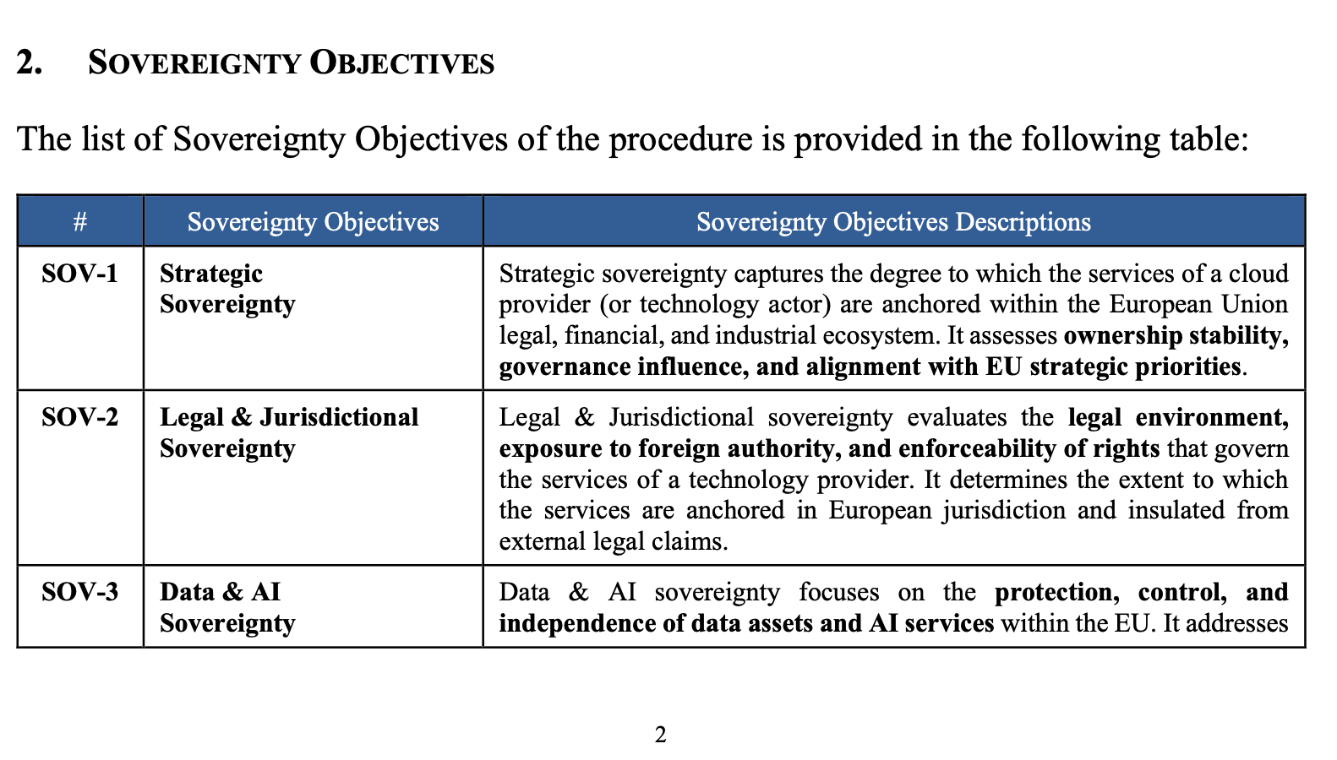
EU - Factors to Determine Sovereignty Risk

Slide 11
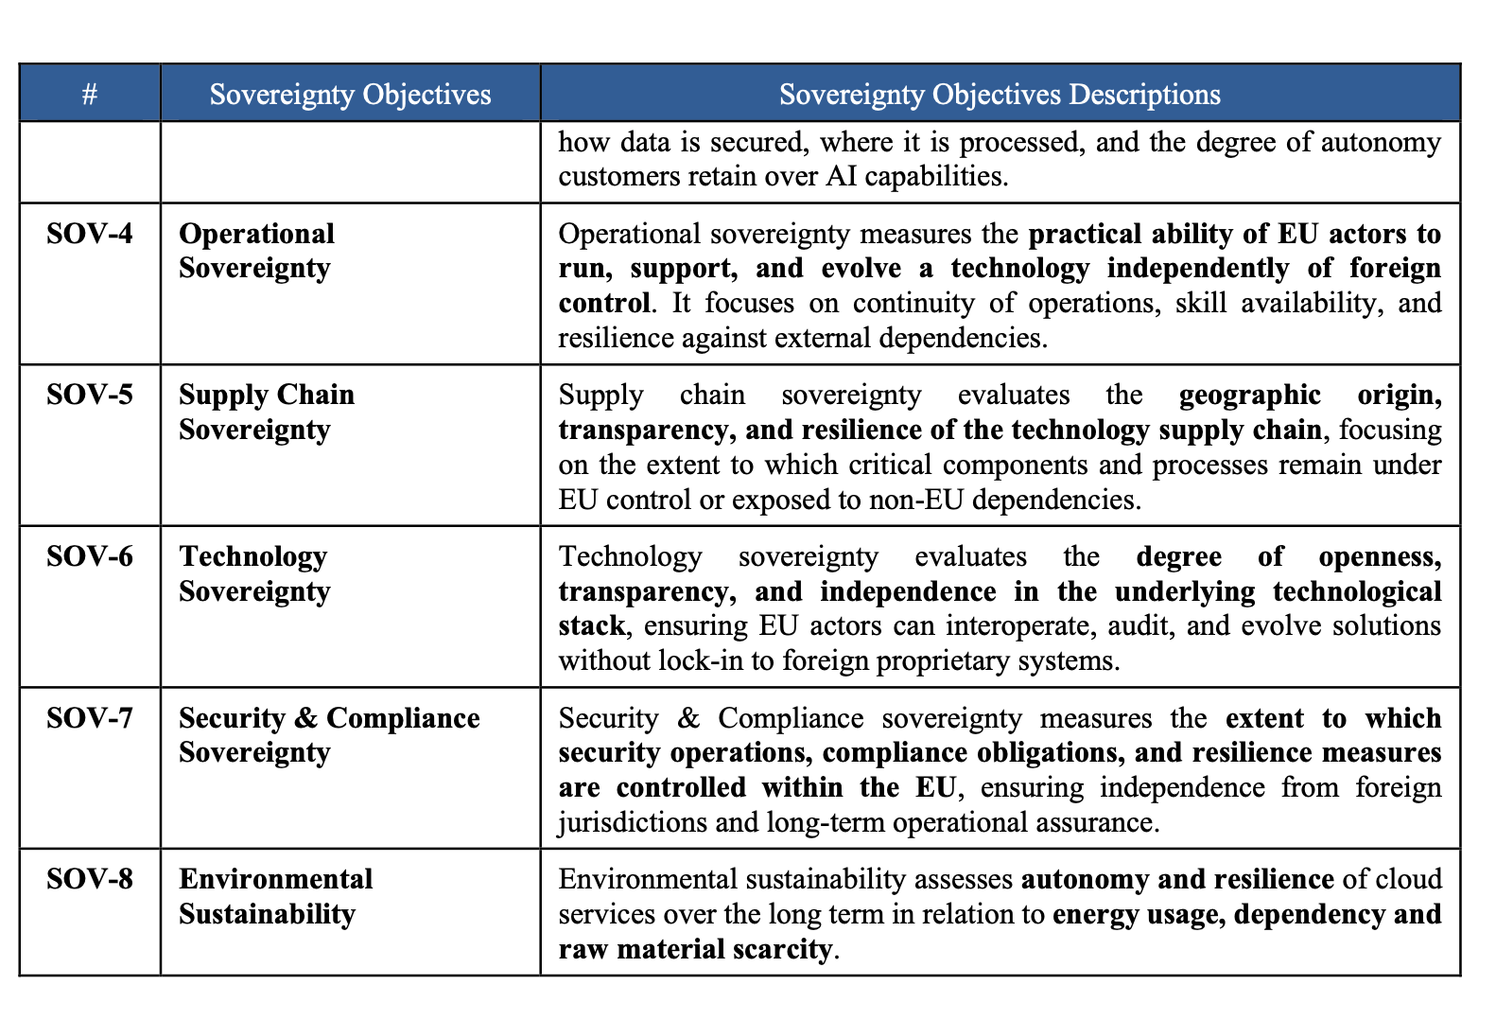
Factors of Sovereignty Risk

Slide 12
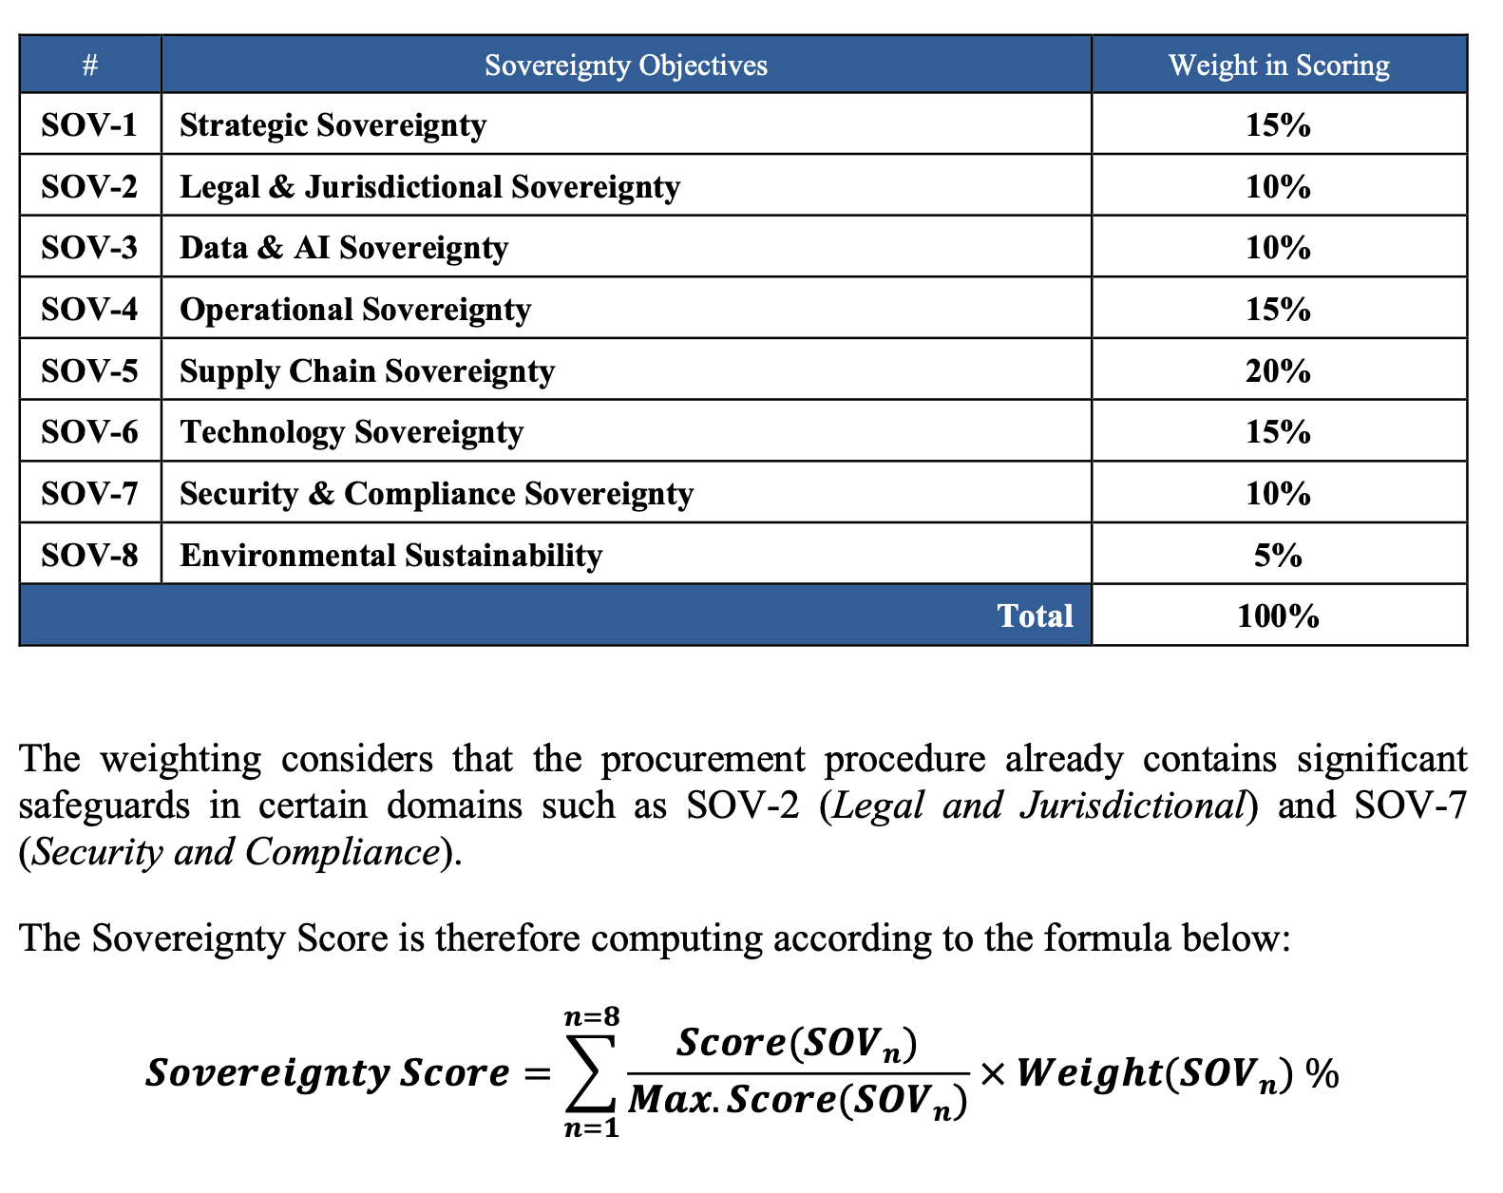
For a GT talk, we needed an equation…

Slide 13
Cybersecurity, Data Localization, and Sovereignty
In the name of sovereignty, tempting to have a “security” rule that prevents data from going to other countries
Our research on the risks from this path:
(1) Swire, Peter and Kennedy-Mayo, DeBrae, The Effects of Data Localization on Cybersecurity - Organizational Effects.”8 Arizona Law Journal Emerging Technology 3 (2025), Available at SSRN: https://ssrn.com/abstract=4030905
(2) Swire, Peter and others (including Crowdstrike team), Risks to Cybersecurity from Data Localization, Organized by Techniques, Tactics, and Procedures. Journal of Cyber Policy, volume 9, issue 1, 2024. Available at SSRN: https://ssrn.com/abstract=4466479

Slide 14
Risks Organized by Techniques, Tactics, Procedures
Techniques, Tactics, and Procedures (TTPs)
Themes
First, data localization laws can disrupt the defenders’ ability to determine “The Who and the What” of an attack
Limits on threat intelligence sharing
Defenders can’t detect privilege escalation when data moves in the organization
Second, data localization laws can result in “Risks From Knowing Less Than the Attacker”
Attackers can cross borders, but defenders can’t do pen testing and red teaming
Notes:
Logo of Mitre Att&ck

Slide 15
Conclusions on Risks to Cybersecurity
Address these risks explicitly in future debates about the advisability of data localization,
Examine the risks; for example, what sorts of third-party services might become unavailable due to localization, with what increased risk?
Second, if there is a general localization regime, policymakers can consider creating exceptions for cybersecurity risk
Third, the risks to cybersecurity from localization – including effects on individuals, corporations, and national security – should be analyzed together with any claimed benefits
Notes:
This Photo by Unknown Author is licensed under CC BY

Slide 16
AI Sovereignty
AI is an area of great-power conflict
U.S. and China have emphasized leadership in global race for AI preeminence
EU’s AI Act – more focused on managing risks to individuals and human rights from AI
Concerns that AI will not lead in AI innovation
What does “AI sovereignty” mean?
The concept of the “AI stack”
Here is one typology:

Slide 17
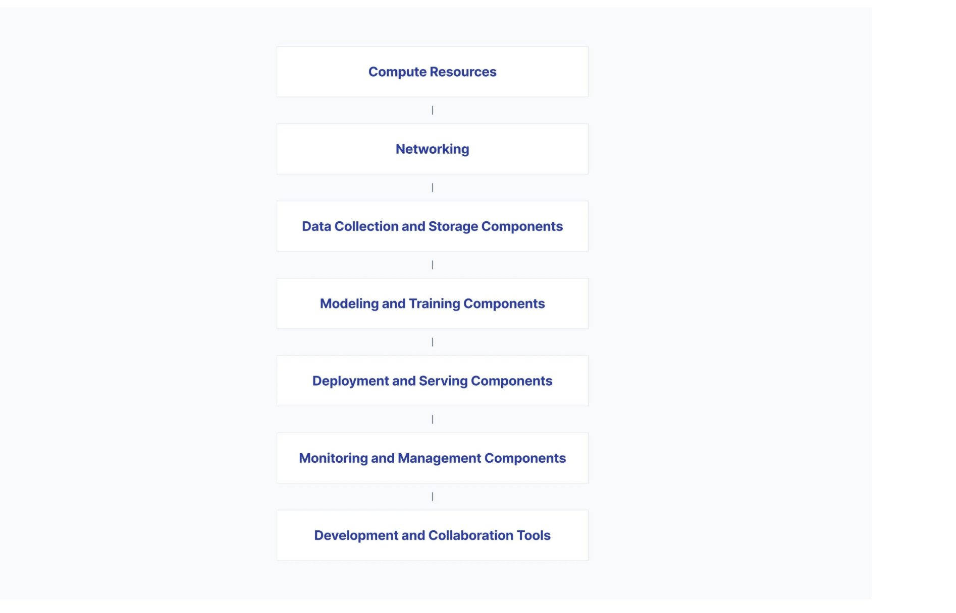

Slide 18
Implications for the U.S., the EU, and business
EU has seen increasing risk in relying on the U.S. for key aspects of digital technology
Cloud computing
Cybersecurity (most services are U.S.-based)
AI
EU investment to foster EU “champions” has not been very successful
Hence, increasing EU concerns about lack of digital sovereignty
U.S., meanwhile, has increased the pressure against EU measures the administration has seen as contrary to U.S. tech companies and U.S. interests

Slide 19
What Opportunities for GT Entrepreneurs?
Desire within the EU to have EU-based digital businesses
Costs to EU if these business provide less than globally-competitive services
Therefore, an opportunity for GT entrepreneurs to provide high-quality services, with less reliance than previously on the US tech industry
There is a business case for that
For me, I am sad to see less trust between U.S. and EU, but the business case may be significant in the next years
However, not all of the layers in the stack are likely to be localized, so keep watchful for what mix of local and global will work best for a company
Next, Theodore Christakis offers his thoughts …

