Slide 1

Encryption & Globalization Revisited: Understanding the Role of End-to-End Encryption
Peter Swire
JZ Liang Chair, College of Computing
Georgia Tech
March 9, 2026

Slide 2
First, a thank you to this group
  Last year, I presented to this group at an early stage for article now called “Personal Data as a Dual-Use Technology: Critically Assessing the New Alliance of Privacy and National Security”
    Our session had a big impact on the article
      Entirely new IR part of the article, which some law professors have praised for being the most novel and interesting contribution
        The realist and liberal internationalists perspectives reveal some of the key aspects of the policy debate that had not been well recognized previously
    Available on SSRN & published soon in Virginia Journal of International Law
    “Personal Data as a Dual Use Technology: Privacy Professionals Face New Export Controls” published by IAPP
    11/25 and 2/26 webinar/panels on the topic

Slide 3
Overview
  Law enforcement and intelligence agencies have worried about “Going Dark” – they seek “lawful access” or “exceptional access”
    The law enforcement intuition – at least where there is a probable cause warrant, issued by a judge, there should be a way for the government to gain access to the communication
    Physical world – that warrant works to enter home or business, and should work online as well
  Helpful to conceive of us currently in Round 3 of the Going Dark debates
    Round 1: 1990’s, the crypto wars
    Round 2: 2010-2015: effects of globalization and cloud computing
    Round 3: globalization and the importance of E2EE
  Note: I have been active in the policy debates for all these rounds, and will note my own role, as one of many who have sought to ensure effective encryption and cybersecurity
  Co-authors for current project are Kenesa Ahmad and Michael Specter (the usual disclaimer – my remarks today)

Slide 4
Going Dark Round 1: the Crypto Wars
Before 1990, cryptography dominated by government agencies
RSA algorithm spread in the 1990’s
  A strong cryptosystem for commercial and other use, lawful in the U.S.
Perspective of law enforcement (FBI, DOJ) and intelligence (NSA/DoD):
    They wanted to keep the ability to wiretap
      1994 CALEA required ability to wiretap for traditional phone network
    They didn’t call it “going dark” but that is what they worried about
    They supported strict limits on export of encryption (a “munition”)
    Clipper chip proposal would use “key escrow” – U.S. government would have the keys even for U.S. commercial use of encryption

Slide 5

1990’s: Email, Web Not Strongly Encrypted
Hi Bob!
Alice
Alice’s Email Provider or Web Serer
%!#&*YJ#$&#^@%
%!#&*YJ#$&#^@%
Internet: Many Nodes Between ISPs
%!#&*YJ#$&#^@%
%!#&*YJ#$&#^@%
%!#&*YJ#$&#^@%
%!#&*YJ#$&#^@%
%!#&*YJ#$&#^@%
%!#&*YJ#$&#^@%
%!#&*YJ#$&#^@%
%!#&*YJ#$&#^@%
Bob’s Email
Provider or Web Server
Hi Bob!
Many Potentially Malicious Nodes
Weak/no encryption = many intercepts
Bob

Slide 6
Going Dark Round 1: The Successful Case for Strong Encryption
Loud opposition to export controls and Clipper Chip
  Protect privacy – limits on government surveillance
  Protect cybersecurity – business on the Internet requires strong encryption
  Support U.S. business – Silicon Valley and E-commerce growth depended on global acceptance of U.S. commercial actors
1999 White House announcement
  End almost all export controls on encryption
    No more administration support for key escrow
  Promise to FBI/DOJ for technical assistance funding to update capabilities
  Important business could use strong encryption (banks)
  As a practical matter, emails etc. were rarely encrypted
    Phone and email wiretaps usually still worked in practice
    FBI/DOJ were not “going dark” in practice

Slide 7
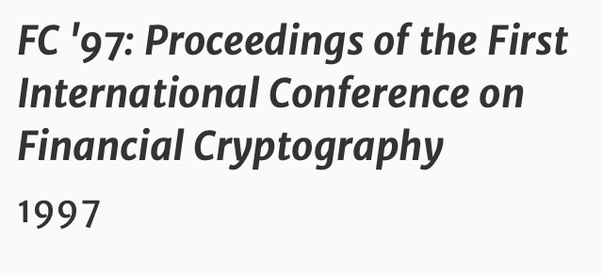
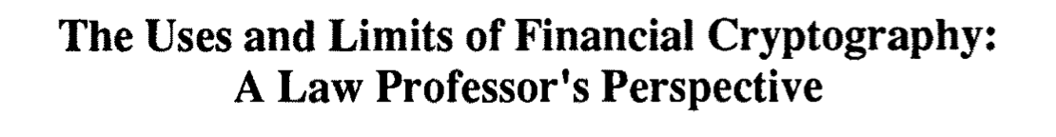
My first encryption publication: for anonymous and pseudonymous financial transactions,
financial cryptography can support debit transactions, but not credit transactions.
That is, it supports only one of the two major categories of financial transactions.
Beginning of my research on encryption:
Not my job: advance technical aspects of encryption
Instead: explain legal and policy implications of how encryption is used

Slide 8
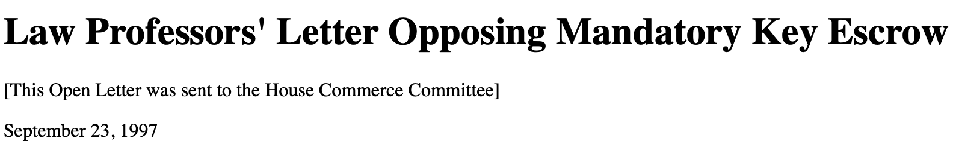
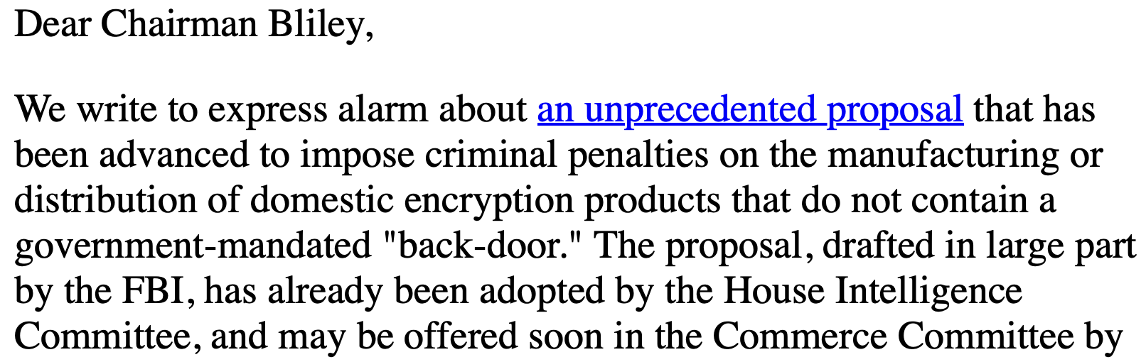
Drafted by Froomkin, Lessig, Swire
Signed by 30 law professors
Legislation was stopped – by this and many other actors

Slide 9

Chief Counselor for Privacy, 1999-2001
*Chair, White House Working Group on Encryption
*Key escrow was critiqued in the Crypto Wars, but the FBI,
DOJ, and DoD still wanted it, until DoD didn’t
*Then, the meeting where AG Janet Reno learned
that she had lost

Slide 10
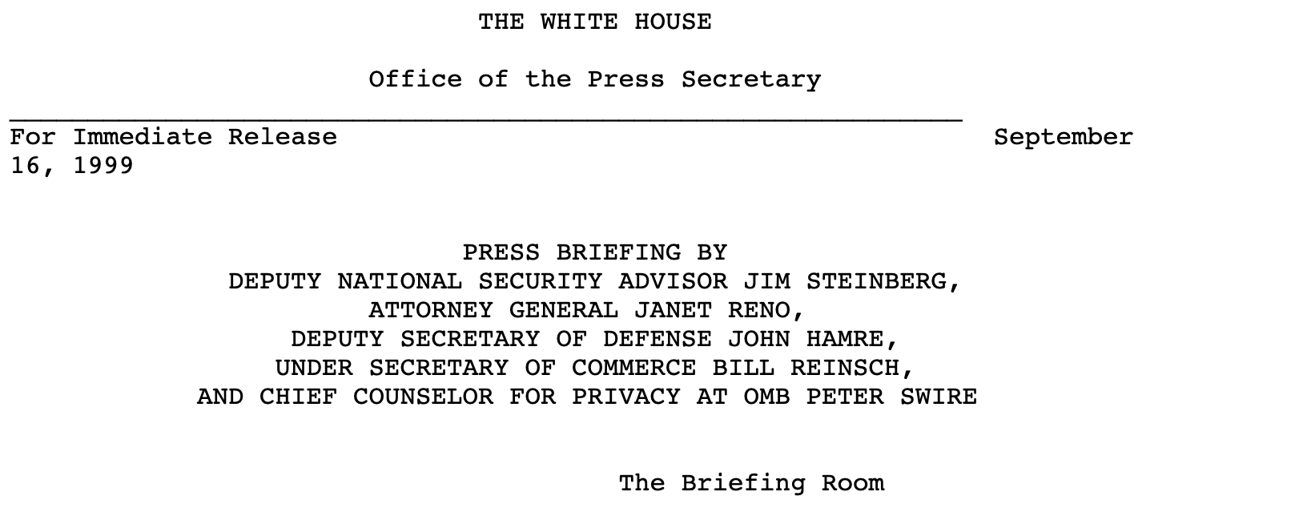
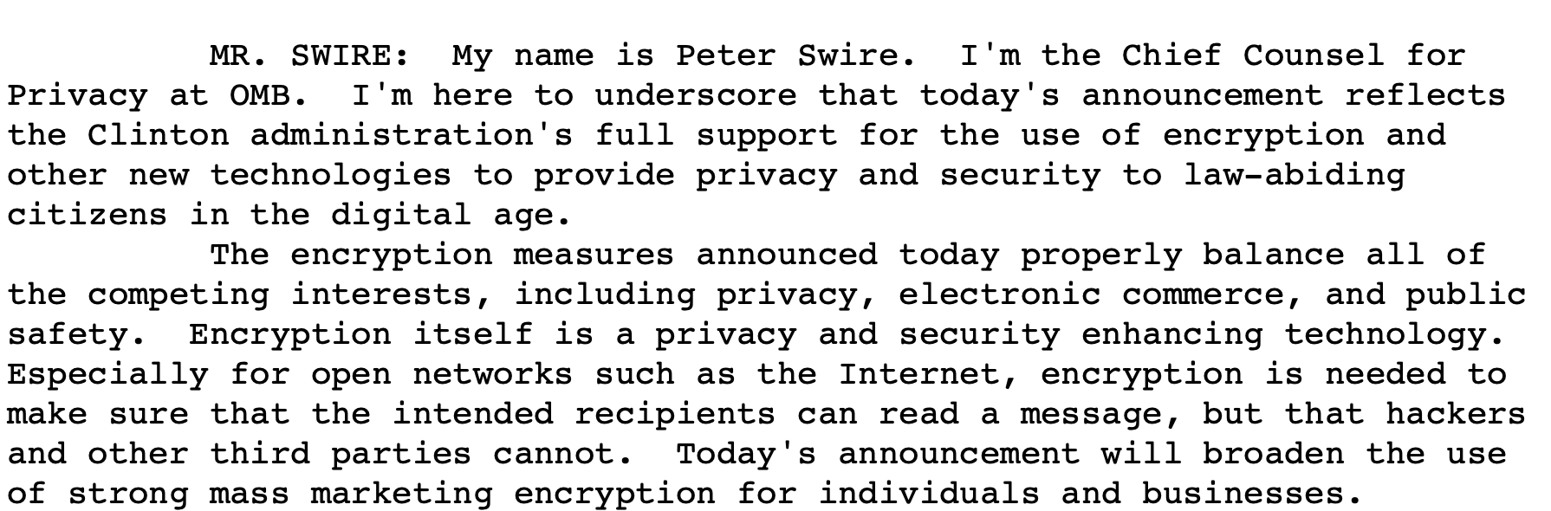

Slide 11
Going Dark Round 2: Encryption and Globalization
Factual background
  India was considering strict limits on strength of encryption (Blackberry, Intel)
  China was considering requiring use of only its standards for encryption, blocking use of global, stricter cryptosystems
  In the U.S. and Europe, the periodic complaints emerged again that law enforcement and intelligence agencies were “going dark”
    FBI testimony in 2011 used the term “Going Dark”
  In short, encryption regulation shifted from U.S. issue (Round 1) to global issue (Round 2)
Two main publications:
  “From real-time intercepts to stored records: why encryption drives the government to seek access to the cloud” (Swire)
  “Encryption and Globalization” (Swire & Kenesa Ahmad)

Slide 12



2010 to 2015: Plaintext at the Server
Hi Bob!
Encrypt
Alice
Alice’s Email Provider Encrypts to Its Server
Encrypted at Alice’s ISP
%!#&YJ@$
– Plaintext at Alice’s Email Provider:
Then, encrypted to Bob’s Email Provider
%!#&YJ@$
Security due to Encryption in Transit:
ISPs can’t access content
Encrypted at intermediate nodes
Wiretaps don’t work!
– Backbone provider
%!#&YJ@$
– Plaintext at Bob’s Email Provider:
Then, encrypted to Bob’s Device
Encrypted at Bob’s ISP
%!#&YJ@$
Decrypt
Hi Bob!
Bob’s Email Provider
Decrypts on Bob’s device
Law Enforcement Can Get Court Order To Access at Email Provider
Bob

Slide 13
“From real-time intercepts to stored records: why encryption drives the government to seek access to the cloud” (2012)
By 2012, with email and rise of cloud computing, encryption in transit was becoming more common
  Even more so after Snowden in 2013, so that major platforms could explain safeguards against NSA etc.
  Law enforcement couldn’t successfully wiretap between Alice and server, or between server and Bob.
  Conclusion: huge increase in importance of law enforcement seeking access to stored communications in the cloud
Law enforcement expanded use of court orders for access through email providers
  Worked well for U.S. law enforcement and intelligence, for U.S. service providers
  Non-U.S. governments could only access email content if approved by a U.S. judge, under a Mutual Legal Assistance Treaty
    Swire project on MLATs, leading to proposal for CLOUD Act, enacted in 2018
    Cross-Border Data Forum created to address implementation of the CLOUD Act and other issues of cross-border government access to data
In sum, cross-border cooperation as response to blocking of wiretaps and rise of cloud computing

Slide 14
Going Dark Round 2: Encryption and Globalization
2 key points in “Encryption and Globalization” (Swire & Kenesa Ahmad, 2012)
First, when considering gaps in encryption, such as government mandates to provide access to law enforcement, cybersecurity is only as good as the “least trusted country” that can access the data
    1990’s encryption policy debates focused on the U.S.
    By 2012, much greater globalization of software, hardware, and devices
      If encryption is broken in one country, the same flaw/back door is available in the other countries
      Analysis of global regulation of encryption, in multiple countries, needed to ensure cybersecurity
      Heuristic – before mandating a back door, consider the country that you trust least (China/US, India/Pakistan, etc.) – as a policy matter would you support that least trusted country having a back door into global communications?
Second, we’re not “going dark”; we are in a “golden age of surveillance”

Slide 15
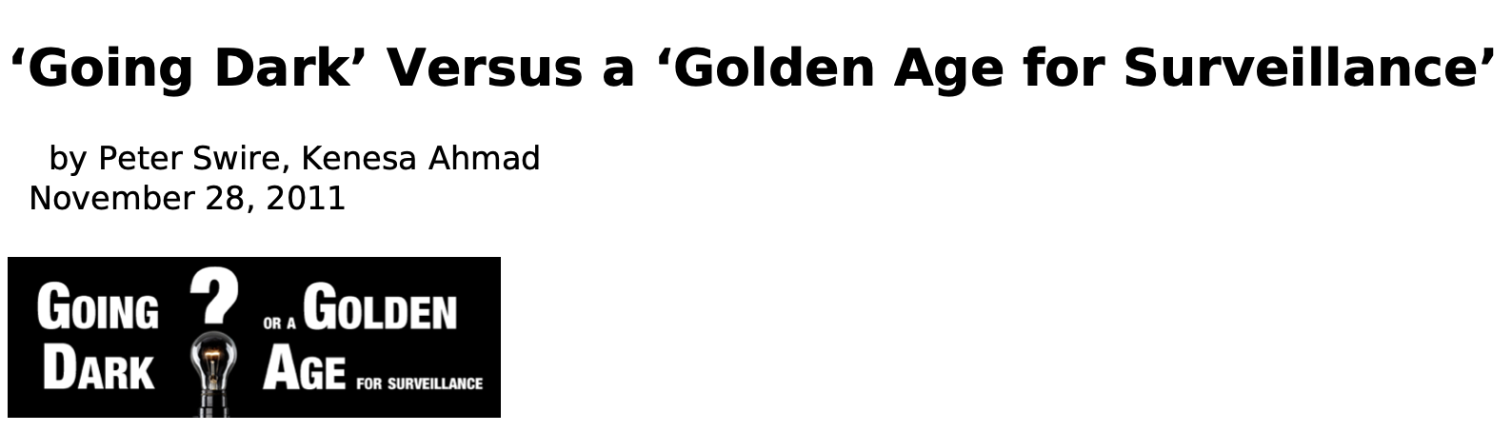
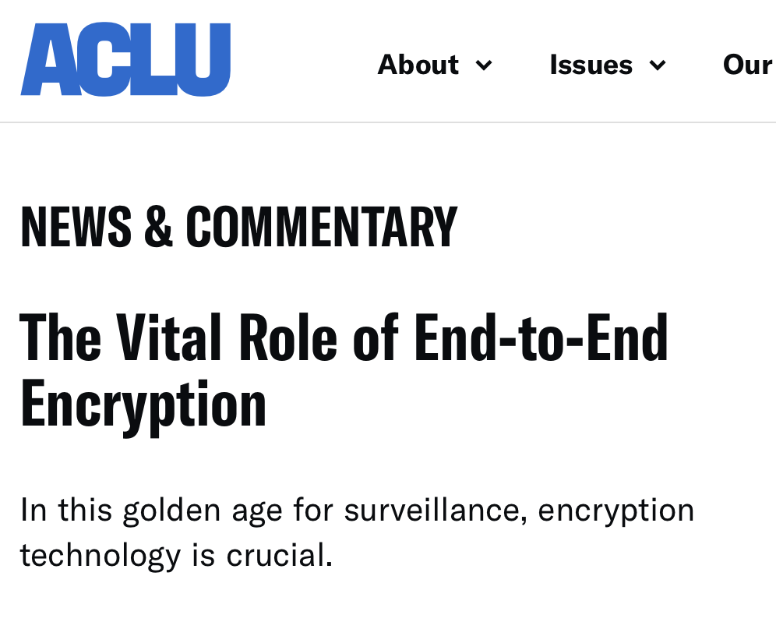
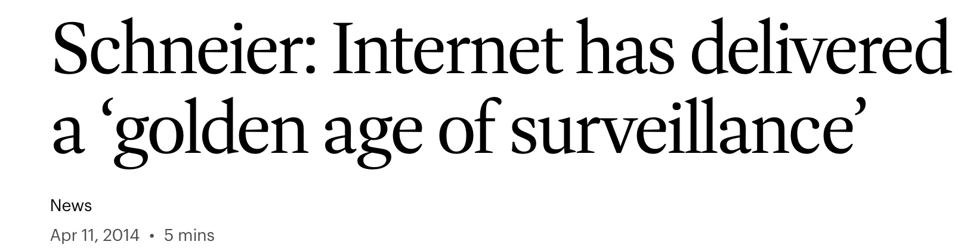
“Encryption and Globalization” (2)
When the FBI complains about “going dark”, would they choose all the data they can access today, or the set of data they could access before the Internet?

Slide 16
Summary on Round 2 of Going Dark
Mostly, the proposed limits on strong encryption failed to pass
  Exception in China, with costly inter-connection at the border between global cryptosystems and China-based cryptosystems
The argument for strong cybersecurity was effective
Rhetorically, and practically, the law enforcement case was weaker than they expected because it actually had become a “golden age of surveillance”
  Range of data and databases available to government had increased enormously
  Specific limits on government access were minor compared to that law enforcement advantage

Slide 17
”Going Dark” Round 3: 2020s and E2EE
For messaging (not emails)
  Apple adopted E2EE for iMessage in 2011
  Meta adopted it in 2023 – E2EE as global default
Government concern:
  No plaintext between Alice and Bob;
  Access to the service provider does not get the content
Proposals: do something to get around E2EE
  FBI jawboning service providers not to switch to E2EE
  EU proposals to require an access point, especially for CSAM
  UK and Australia enact “technical capacity notices,” requiring an access point
  Other countries as well
Round 3 is different at the technical level , but hasn’t been explained clearly to law and policy audiences
  At least five technical variations on how E2EE operates
  E2EE has spread deep into the infrastructure, and not only used for messaging

Slide 18
Messaging: E2EE
1
Hi Bob!
Encrypt
Alice
Bob's public key
Encrypted message –
%!#&YJ@$
– Alice's local ISP
%!#&YJ@$
– Backbone provider
%!#&YJ@$
– Bob's local ISP
%!#&YJ@$
Decrypt
Hi Bob!
Bob's private key
Messaging App Lacks Access to Content
Bob

Slide 19
5 Technically Distinct Forms of E2EE
The concept of “endness” (Hale & Komlo 2022)
  Technical definition of possible properties of what counts as an “end” in E2EE
  How that definition applies to scenarios has not really been explained
  No discussion to date for law and policy audience
Today, propose 5 scenarios for the recipient “end”, with different implications for law, policy, and technical response when 3d party seeks access

Slide 20
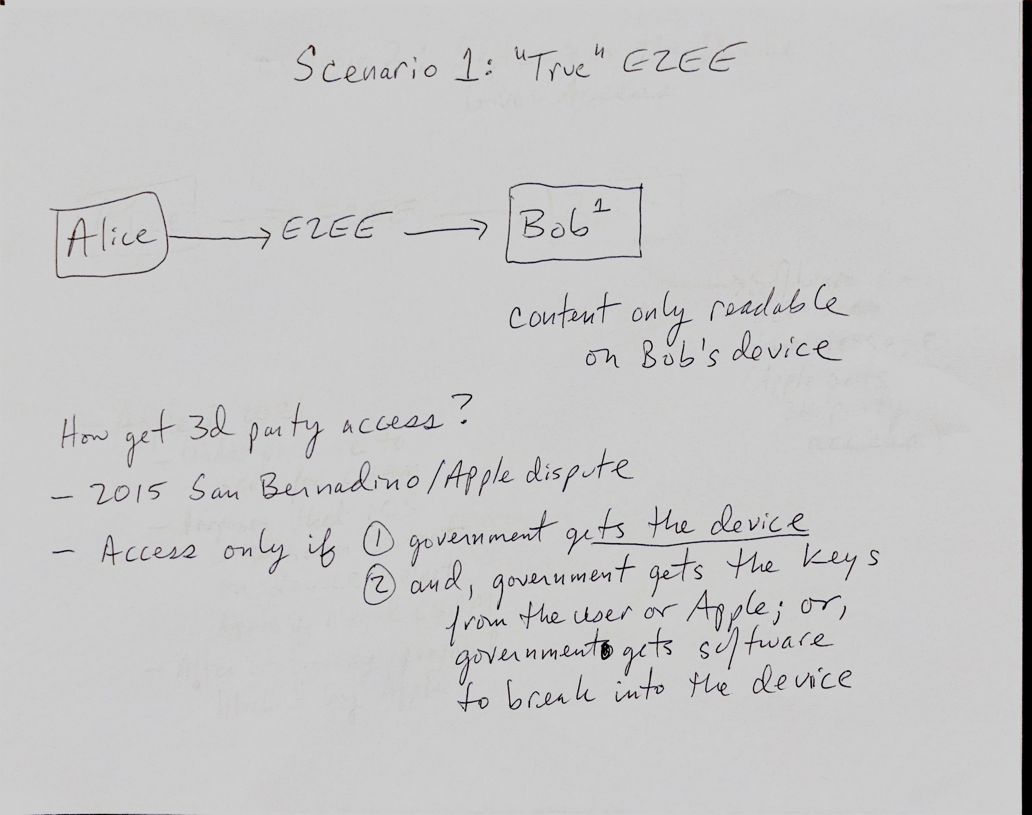

Slide 21
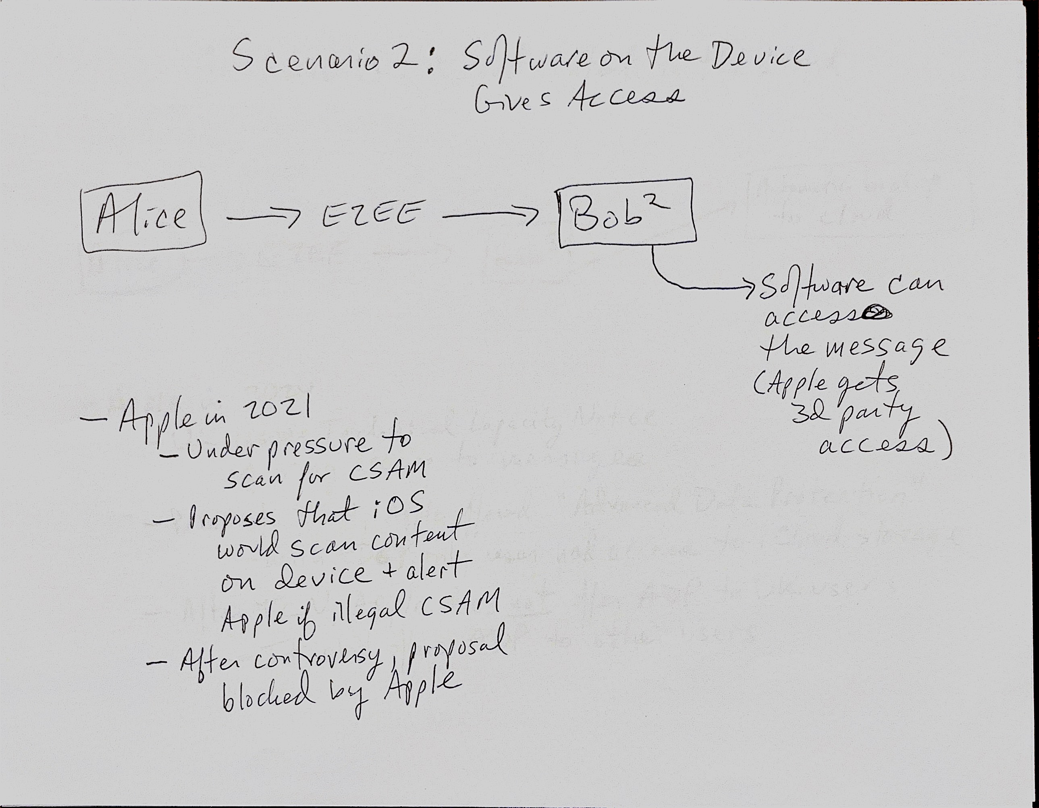

Slide 22
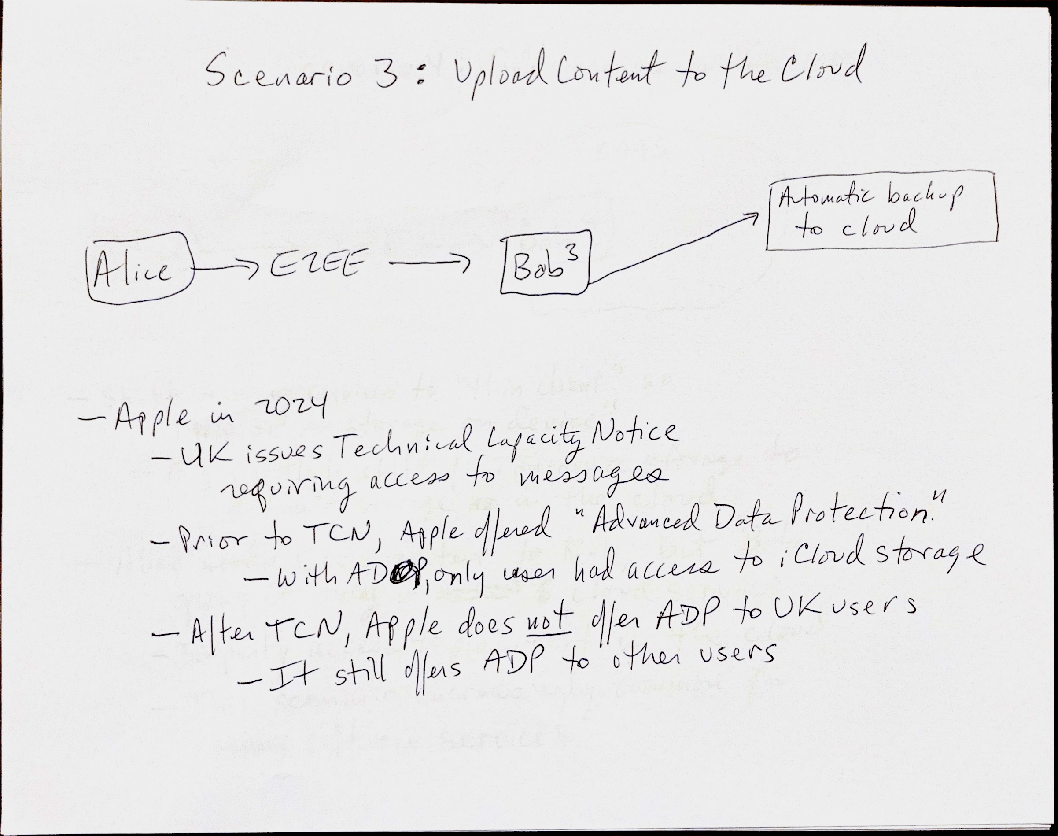

Slide 23
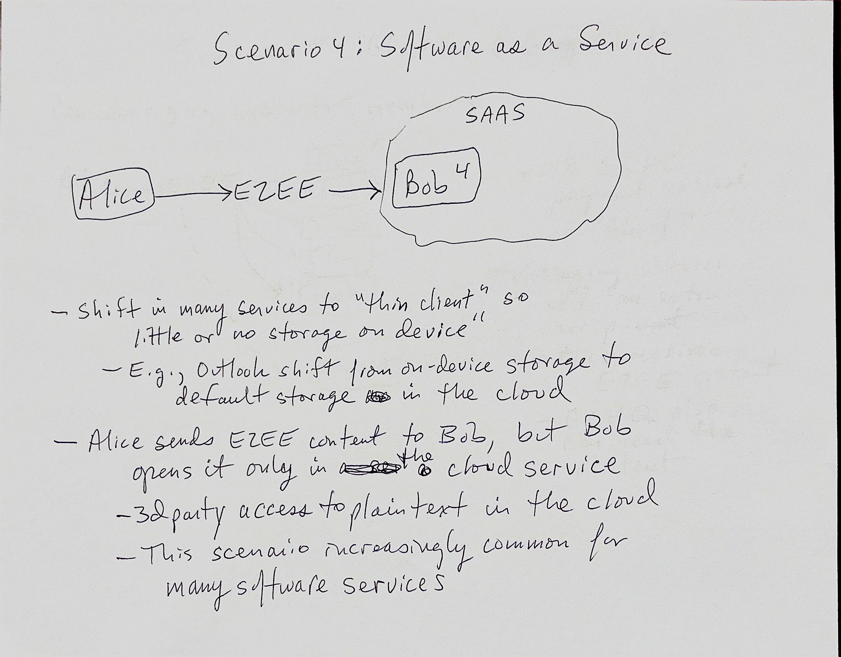

Slide 24
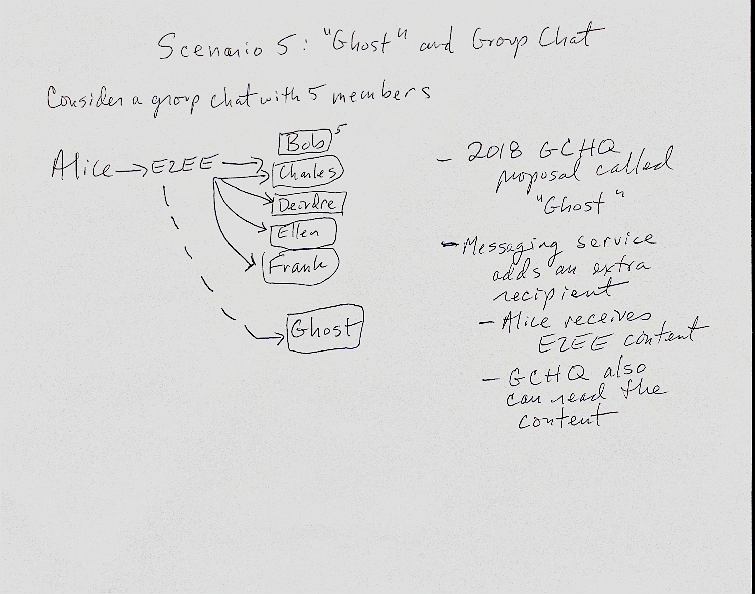

Slide 25
E2EE: From Messaging to Infrastructure
Public policy discussion of E2EE has previously & understandably focused heavily on messaging
  Messaging is done by billions of ordinary users
  Some of those users are relevant to law enforcement or intelligence investigations
  Below, we will look at policy implications of trying to break E2EE messaging
Since 2010, E2EE has become salient in many aspects of online infrastructure
  If try to regulate “E2EE,” and miss the infrastructure role, then policymakers can badly misunderstand the implications of a law or policy
  We explain key ways E2EE is used in online infrastructure
    E2EE applications that shield/obscure information
    Applications that improve E2EE through authenticity, transparency, or integrity

Slide 26
E2EE in the Infrastructure
HTTPS protocol uses Transport Layer Security (TLS)
  TLS is the updated and stronger version of SSL, creates E2EE link between user and website
Shift from HTTP to HTTPS
  Before 2013, most web traffic was unencrypted. HTTPS, the encrypted version of the protocol used to load web pages, was reserved for banking, e-commerce, and login pages.
  By 2024, more than 90 percent of web page loads used HTTPS.
  Thus, man-in-the-middle attacks (and wiretaps) are blocked for user’s web traffic
IPSec and rise of VPNs – network level E2EE
Authenticated encryption provides integrity and authentication in addition to earlier role for confidentiality
Zero-trust architectures embody encryption as a design requirement

Slide 27
Policy Issues for E2EE in the Infrastructure
Far greater risk of problems if there is any policy attempt to regulate “E2EE”, because E2EE is used far beyond the messaging app use case
For any attempt to regulate the infrastructure, risk of cybersecurity problems applies to all the software, hardware, and devices that rely on that aspect of the infrastructure
  Not just a mechanism for government access to content of a limited number of individual communications
IETF standards (RFC 2804, 8804) prohibit built-in mechanisms for intercepting communications
Weaknesses in infrastructure raise the “least trusted country” concern
The lawful access debate should be reframed as an infrastructure-design question, not an application-design question.
[Your thoughts/comments/questions?]

Slide 28
Policy Issues for the 5 E2EE Messaging
Update the “least trusted country” and “golden age of surveillance” facts from 2012 to today
Scenarios 2 to 5 all would create a software failure that can be exploited remotely
  The back door used by one nation state subject to being used by other adverse actors
Although many encryption advocates are reluctant to discuss it, there is an argument that Scenario 1 has different equities
  By definition, Scenario 1 requires access to an individual device, and cannot be exploited remotely
    Query whether that condition actually is always true
  If it is true, then “exceptional access” really becomes more exceptional, applying only when a government has taken control of an individual device
    Policymakers can differ on whether that provides a rationale for some mechanism, under judicial control, for accessing that single device
    We do not take a position on that, but the five threat models show that different architectures may lead to different policy outcomes

Slide 29
Conclusion
Thank to the group for this March 9 deadline forcing my co-authors and I (Kenesa Ahmad, Michael Specter) to get this project into something presentable
Description: go beyond the simple messaging use case of E2EE to show:
  How the “going dark” concern applies differently to ”plaintext at the server” (Round 2) and E2EE (Round 3)
  At least 5 different threat models to E2E encrypted messaging
  Pervasive role of E2EE in online infrastructure
Prescription:
  Round 2 conclusions are still true: for globalized uses of encryption, beware the least trusted country and we live in a golden age of surveillance
  Round 3
    Don’t mistake the simple case for the current more complex reality
    Strong cybersecurity and privacy arguments exist against legal restrictions on E2EE, although the details of these arguments vary depending on the type of E2EE

