Slide 2
PETs, AI and Cookieless
Framework for New Adtech and Metrics Approaches

Slide 3




WELCOME AND INTRODUCTIONS
Hannah Crowther
Partner Data protection & privacy
Bristows LLP
Alasdair Macdonald
Group Manager, Online Tracking Team, Technology Department
U.K. Information Commissioner’s Office
Peter Swire
J.Z. Liang Chair
Georgia Institute of Technology
Peter Craddock
Partner
Keller and Heckman LLP
Moderator

Slide 4
AGENDA OUTLINE
Welcome and Introductions
Introduction to Privacy-Enhancing Technologies
Legal framework
Knotty questions:
  PETs, cookieless & more
  AI in advertising
Roundtable discussion
Questions and Answers
Closing Remarks

Slide 5
Privacy-Enhancing Technologies
PET:
  Digital solution for processing of information
  Enabling the deriving of value from information
  While minimizing risk re data protection, security, confidentiality, privacy

Slide 6
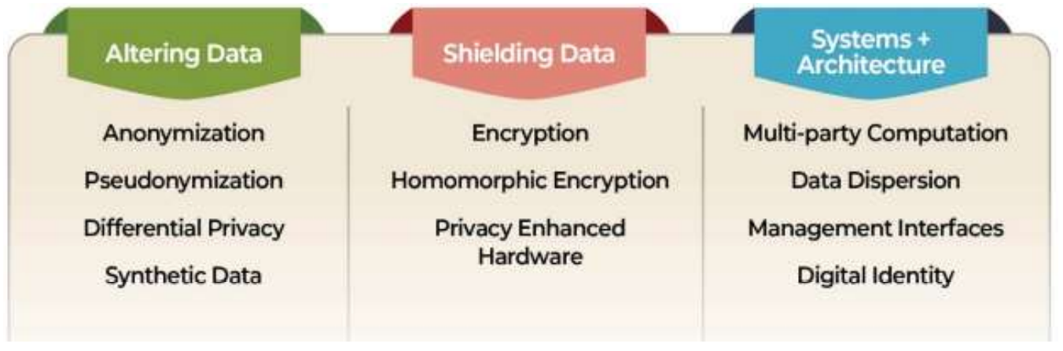
Categories of PETs
Source: Federal Reserve Bank of San Francisco, FinTech Edge Special Report,
Privacy Enhancing Technologies: Categories, Use Cases, and Considerations, p. 4

Slide 7
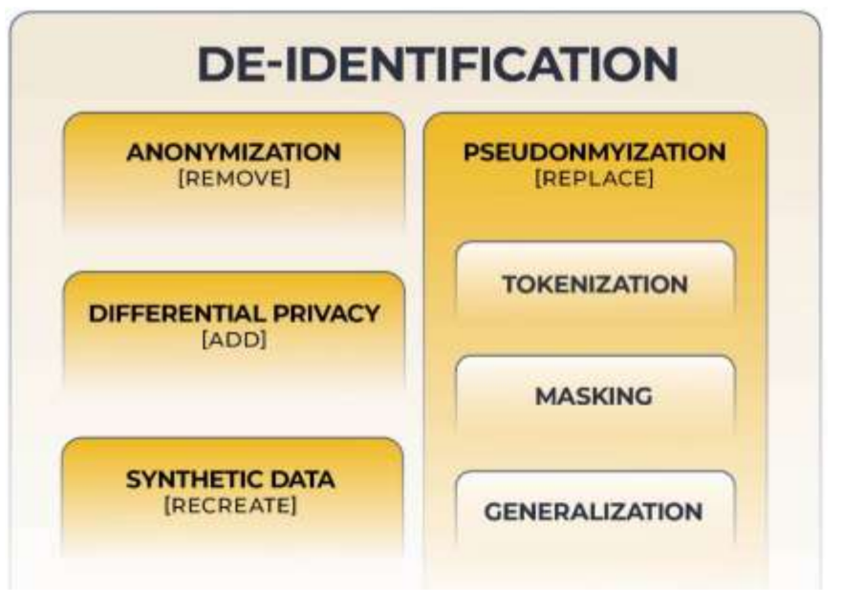
Source: Federal Reserve Bank of San Francisco, FinTech Edge Special Report,
Privacy Enhancing Technologies: Categories, Use Cases, and Considerations, p. 7

Slide 8
The legal framework
GDPR
PECR
  ICO guidance on “storage and access technologies”
  EDPB Guidelines on Art 5(3) ePrivacy Directive
  ICO opening re PECR & non-enforcement?

Slide 9
Knotty Questions: PETs, cookieless & more
GDPR:
  Is it personal data?
    From whose perspective? [EDPS v SRB]
  Who is a controller?
Does PECR apply?
  Storage vs memory?
  Gaining of access?
  “Service” consent exemption?

Slide 10
Legal benefits of PETs | Legal challenges of PETs
Data protection by design | PECR consent
Reduced security risk | GDPR consent
Data minimization | Explainability
Reduced purpose limitation risk?
LI balancing test?
Compatibility test?

Slide 11
  If legal regime identical for PETs / cookieless / …, why use them?

Slide 12
Knotty Questions: AI in advertising
GDPR:
  Is personal data involved?
    AI pattern detection vs personal data processing?
  Automated decision-making?
    Edge cases?
Does PECR apply?
  Gaining of access? Where does the AI component run? [server-side vs client-side?]

Slide 13
RESOURCE LIST
About PETs:
  OECD, Emerging Privacy Enhancing Technologies: Current Regulatory and Policy Approaches, March 2023
  Federal Reserve Bank of San Francisco, FinTech Edge Special Report, Privacy Enhancing Technologies: Categories, Use Cases, and Considerations, 2021
ICO:
  Strategy for levelling the playing field for online tracking in 2025
  Guidance on the use of storage and access technologies

Slide 14
How Did Things Go?
(We Really Want To Know)
Did you enjoy this session? Is there any way we could make it better? Let us know by filling out a speaker evaluation.
Open the Cvent Events app.
Enter IAPP DPI25 (case and space sensitive) in search bar.
Tap "Schedule" on the bottom navigation bar.
Find this session. Click "Rate this Session" within the description.
Once you’ve answered all three questions, tap "Done".
Thank you!

