Slide 1

Keynote: Personal Data as a Dual-Use Technology: Privacy, AI & National Security
Peter Swire
Case Western JOLTI Conference
Code and Consequence: Where AI Meets Cybersecurity
April 10, 2026

Slide 2
National Security, Data, and Other New Laws
The intuition: risky to national security if adversary nations have access to sensitive data of Americans
  Duke data broker study – data brokers sell precise geolocation data to track military and other personnel for a few cents/person
  If you were a member of Congress
    Comfortable if adversary nations can track U.S. military personnel?
    Comfortable if adversary nations can train their AI models on sensitive personal data of US persons?
  As a result, important new U.S. laws to limit transfer of personal data to adversary nations
  Today’s talk – critical analysis of this new legal trend

Slide 3
Our Current Research
Peter Swire & Samm Sacks
“Personal Data as a Dual Use Technology: Critically Assessing the New Alliance of Privacy and National Security”
  Forthcoming soon, Virginia Journal of International Law
  Earlier version available on SSRN
That article follows previous US/China data writing by Swire and Sacks
Also, Swire, “Personal Data as a Dual-Use Technology, Privacy Professionals Face New Export Controls”, IAPP 11/25

Slide 4
Overview of Today’s Talk
Swire background, including on US/China data flows
Export control perspective – personal data as “dual use” and subject to export controls
  Important new U.S. legal measures about sensitive personal data
China expert perspective – do we want to de-risk or de-couple?
Privacy perspective
  Privacy OR National Security; Privacy AND National Security
International Relations/national security studies literature
  Strict export controls not a good fit with teachings from IR
Apply these perspectives to AI, national security, and privacy
Conclusions

Slide 5
Swire Background
Currently:
  JZ Liang Chair in the Georgia Tech School of Cybersecurity & Privacy (since 2013)
    Also, Professor of Law and Ethics, Scheller College of Business
  Founded Cross-Border Data Forum (2018)
    Co-author Samm Sacks is a Senior Fellow at CBDF, plus Yale, New America
Previously:
  Law Professor since 1990, when not in government
    University of Virginia, Ohio State, George Washington
  Government service in privacy and national security

Slide 6
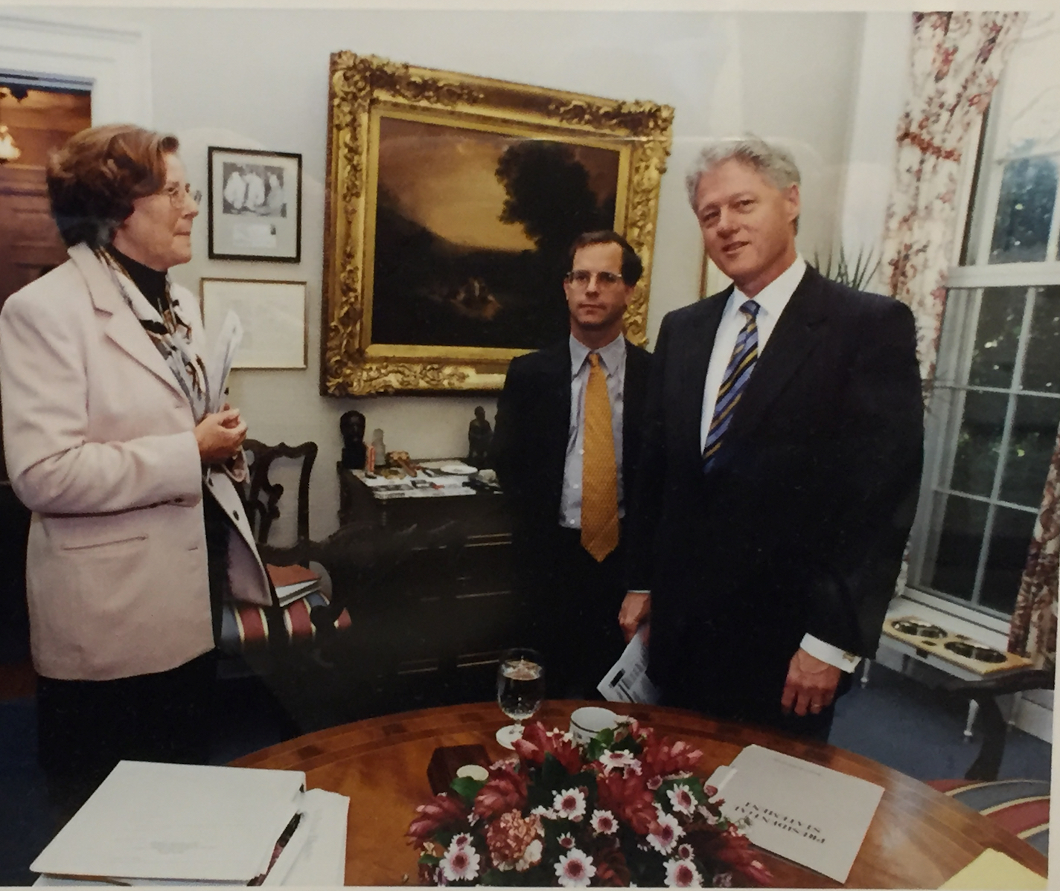
Chief Counselor for Privacy, OMB (1999-2001)
Commercial privacy: HIPAA, Gramm-Leach Bliley
National Security: encryption
National Security: update wiretap laws for the Internet age

Slide 7
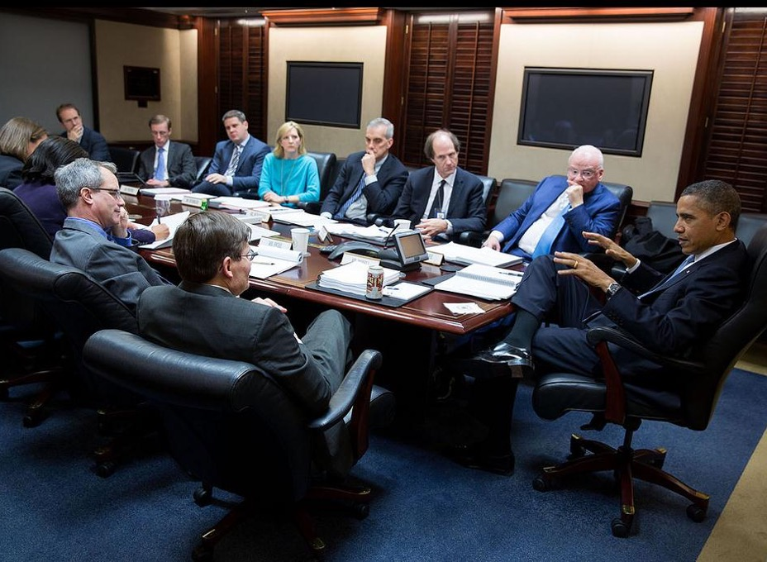
NSA Review Group – National Security
After Snowden released his files
How achieve national security and privacy?
Only one Internet, with multiple goals
Today, those goals include AI policy as well, because AI is critical for privacy and national security

Slide 8
“Assessing U.S. Data Policy Toward China: A Proposed Framework” Sacks & Swire (July, 2023)
Four models:
  Digital Free Trade Model
  Blocking Adversaries Model (cybersecurity)
  Privacy Law Model
  Data Allies Model
    Encourage free flow of data, especially with rule-of-law democracies
    Potentially limit flows of data to adversaries or other nations that don’t protect privacy and human rights
Goals both reinforce and conflict with each other
  Many assume free trade in tension with national security
  However, successful U.S. trade has national security advantages:
    “Soft power” advantages from successful U.S. trade, including mindshare in 3d countries
      Imagine if U.S. cloud providers or AI chips were blocked from those markets, and most of the world uses Chinese providers
    Access to data such as under FISA 702

Slide 9
Export Control Perspective
“Dual use” technologies – both military & civilian uses
  Historically, fighter jet technology
  Already have numerous categories of dual use technologies
  New today -- treat personal data as a dual use technology
Two initial observation:
  “The beginning of the end of the free flow of data”
    That was longstanding US policy since the 1990’s and start of the commercial Internet
  Regulation of data for national security purposes, not protecting individual rights

Slide 10
Risks if Sensitive Personal Data Goes to Adversary Nations
The intuition: risky to national security if adversary nations have access to sensitive data of Americans
Sensitive data to adversary nations:
  Intelligence advantages – they learn about U.S.
    No similar U.S. visibility about Russia/China individuals
  Counter-intelligence advantages – they learn about U.S. actions such as spies
  Influence operations – blackmail etc. using the data
  AI model training for these and other goals
    And, U.S. lacks similar access to data on individuals in authoritarian countries

Slide 11
Export Control Perspective: Legal Measures Treating Personal Data as a Dual-Use Technology
CFIUS - Grindr and others
Tiktok ban
Protecting Americans’ Data from Foreign Adversaries Act (PADFA)
DOJ Bulk Data regulation (in effect now, with civil and criminal penalties)
Connected cars, and others, part of broader set of national security export controls

Slide 12
Two Key Legal Measures
“Bulk Data Rule” (EO 14117) to limit bulk data sales to foreign adversaries (2/24)
  NPRM issued 10/24, now in effect. Enforced by DOJ
  Swire/Sacks, “Limiting Data Broker Sales in the Name of U.S. National Security: Questions on Substance and Messaging” (Lawfare Feb 2024)
New law: Protecting Americans’ Data From Foreign Adversaries Act (4/24)
  Passed 500-0 in House, never got a mark-up in either chamber
  Swire, “White Paper on Clarifying Definitions in the Protecting Americans’ Data from Foreign Adversaries Act of 2024” (May 2024)
  Definitions broad:
    Apply to sensitive data of one U.S. individual to China
    Apply to first-party data about website use, beyond state “sensitive data” definitions
  Enforced by FTC – new enforcement letter to data brokers

Slide 13
DOJ Rule on Bulk Data Sales: Countries of Concern
China
Russia
North Korea
Iran
Cuba
Venezuela

Slide 14
Covered Persons
Prohibited transactions with “covered persons”
Does not apply to “U.S. persons”
Broad definition of entities owned or controlled by countries of concern:
(1) foreign entities that are 50 percent or more owned by a country of concern, organized under the laws of a country of concern, or has its principal place of business in a country of concern;
(2) foreign entities that are 50 percent or more owned by a covered person;
(3) foreign employees or contractors of countries of concern or entities that are covered persons;
(4) foreign individuals primarily resident in countries of concern.
Also, anyone on a prohibited “entities” list

Slide 15
Sensitive Personal Data and Limits for “Bulk”
Precise geolocation data (1000 devices)
Biometric data (1000)
Genomic (and other ‘omic) data (100)
Personal health data (10,000)
Personal financial data (10,000)
Certain personal identifiers (somewhat narrower than PII) (100,000)
Note: many of these routinely occur for online commerce

Slide 16
Covered data transaction
“A covered data transaction is any transaction that involves any bulk U.S. sensitive personal data or government-related data and that involves: (1) data brokerage; (2) a vendor agreement; (3) an employment agreement; or (4) an investment agreement.”
Ban on “data brokerage”
  Definitions of “bulk” vary by category of sensitive data
  Target any sales (access more generally) of sensitive personal data
Broad scope of vendor/employment/investment agreements
  These would be subject to new data security rules, not outright ban

Slide 17
Broad definition of “data brokerage”
“The program would define data brokerage as the sale of, licensing of access to, or similar commercial transactions involving the transfer of data from any person (the provider) to any other person (the recipient), where the recipient did not collect or process the data directly from the individuals linked or linkable to the collected or processed data.”
Examples of “data brokerage” under this definition that are different from what state laws or usual practice consider “data brokerage”
  For instance, first-party web traffic data, which is not “sensitive” under California or other state privacy law
  Compliance challenges
    New categories of personal data
    Counter-parties, “know your customer”
    Query – what if transfer to a recipient, who then transfers to China? Sanctions could easily expand

Slide 18
One Significant Provision
Rule applies “regardless of whether the data is anonymized, pseudonymized, de-identified, or encrypted”
  Rationale – protect against advanced persistent threats – countries of concern
  National security goal – can understand this
As a privacy law, potentially very broad implications
  HIPAA: once data is ”de-identified”, can be released publicly
    But, perhaps can’t be released to adversary nations?
  Data on the Internet is pervasively encrypted
    Swire new article soon: “Encryption and Globalization 15 Years Later: End-to-End Encryption and the Third Round of the “Going Dark” Debate”
    Internet backbone to Hong Kong, legal to use this backbone?
  Thus, tension between national security goal and privacy operational and compliance programs
    Even more so if dual-use regulations on data expand

Slide 19
China Expert Perspective
China experts have a broad debate on how much to “de-risk” or “de-couple” the US from China
  If de-couple a lot, then natural to put strict limits on data flows
  If believe in “free trade” or “entanglement” as a way to reduce conflict, then don’t put strict limits on data flows
  Goldilocks goal: de-risk the items with highest risk and least benefits
    Personal data about online surfing?
    AI data?
      Persistent query about whether to keep China dependent on US chips and software or incentivize them develop their own indigenous technology

Slide 20
China Experts: Some US/China Convergence
Previous “don’t transfer” baseline for China and personal data
  Personal data is a national security priority for China
  Cybersecurity law and near-total ban on transfers out of China
  PIPL – Chinese privacy law and limits on transfers
  BUT, some recent softening, perhaps to encourage the economy and assist Chinese companies to succeed abroad
  Therefore, default ban on data transfer, but some is ok
Previous “transfer” baseline for US
  “Free flow of data on the Internet”
  BUT, new national security perspective
  Therefore, default permission to transfer data, but some limits
Bottom line: opportunity for convergence and international agreement, at least for less sensitive personal data?

Slide 21
Privacy Perspective on Dual Use and Data
Historically, “Privacy OR National Security”
  Brandeis: “conferred, as against the Government, the right to be let alone –––– the most comprehensive of rights, and the right most valued by civilized men.”
  Foreign Intelligence Surveillance Act for national security investigations
    Privacy advocates: limit government when it claims national security as a reason for wiretaps
    National security advocates: this data is essential and agents of foreign powers should not operate with impunity in the U.S.

Slide 22
Privacy AND National Security?
Bulk Data Rule and PADFA – put limits on personal data to other countries, in name of national security
Privacy advocates – put limits on personal data processing, including for
  Data brokers
  Real-time bidding
Opportunity for political coalition in Congress
  500-0 vote in favor of PADFA
Fortunate overlap in compliance programs:
  Data inventory
  Tag data by geography
  Manage contracts and supply chains
For privacy advocates, what other limits might be achieved legislatively or otherwise with this new political coalition with national security?

Slide 23
International Relations Perspective
Empirical (Vaynman and Volpe)
  “Dead zone” for previous arms control treaties where:
    Hard to distinguish civilian/military for the dual-use technology (evasion)
    High integration/ubiquity (i.e., no specialized supply chain for enforcement)
IR Realist critiques of limiting export
  Perhaps export controls accelerate indigenous Chinese tech innovation
  Possible futility – rules not strict enough to stop an advanced persistent threat
Liberal Internationalist critiques of limiting export
  Longstanding “free flow of data” U.S. policy, for democracy, free markets, and free societies
  Privacy human rights tradition – “privacy should not be a right that depends on the passport in your pocket”
  Chander “national security state” – militarization of data flows will not help democracy and human rights

Slide 24
Questions for the Emerging National Security Consensus
Will the rules be effective, to block data flows to China and other adversaries?
  Good idea to create a U.S. “National Security Firewall”, analogous to Great Firewall of China?
Will these rules succeed as a sanctions regime?
  Sanctions regimes tend to work better to address acute harms, for short period
  Over time, evasion of sanctions often succeeds
How do national security risks compare to national security advantages of U.S. engagement with the world?
  If U.S. rules apply to transfers through other countries, what happens when data transfers to Latin America, Africa, and rest of the world?
  Soft power and other national security advantages from continued engagement
  Game-theory challenge – when to cut adversary nation off (limit risks from US helping the adversary) vs. when to sell to adversary nation (keep them reliant on US ecosystem, and create “chokepoints”)

Slide 25
Applying the Analysis to Artificial Intelligence
Swire engagement on AI
  In cybersecurity courses, teach
    “AI for Cybersecurity” – the need for AI to respond at machine speed
    “Cybersecurity for AI” – AI is critical infrastructure that needs effective cybersecurity measures against poisoning etc.
    Recent guest lectures: Cloudflare, Crowdstrike, Workday
  For privacy, extensive AI work with Cross-Border Data Forum, especially with European Research Director, Theodore Christakis

Slide 26
AI, National Security and Data
Great power competition and artificial intelligence
  Chinese advantages include:
    Access to data on large population
    Government scope to mandate data into datasets
  U.S. advantages include:
    Commercial AI software success and leadership
    Advanced AI chips
    Cloud infrastructure and $$ investment, to scale AI

Slide 27
AI, National Security and Data
A national security lens
  Personal data as strategic asset for great power competition
    Idea of “AI sovereignty” or “national AI” highlights risks if “our” data goes to them
    But, consider risks if have data localization
      Cybersecurity: CBDF articles on risks from data localization, such as threat hunting, escalation of privileges, and degrading penetration testing
      AI models – risks of bias and worse outcomes if lack of diversity in data
  Large legal and compliance challenges if seek to retain data only within the U.S.
  Access to high-end chips:
    US prohibit access to high-end chips, to help the US in the “race” with China
    US enable pretty good chips to China, to keep them in the US ecosystem, increase dependence as a chokepoint, and avoid indigenous innovation
    Tricky empirical assessment

Slide 28
Some Tentative Thoughts on AI and Data Transfers
Rules at most will be only somewhat effective, to block data flows to China and other adversaries
  Hard to imagine creating an effective U.S. “National Security Firewall”, analogous to Great Firewall of China?
  Data “hawks” say should at least close the “front door” – the easy access to data brokers
    Data “doves” believe advanced persistent threats can create front companies to buy the data
Sanctions regime?
  Sanctions regimes tend to work better to address acute harms, for short period
  Over time, evasion of sanctions often succeeds
    Thus hard to get long-term U.S. advantage
    However, if you believe it’s a “race” for first-mover, even modest sanctions may help
National security risks vs. national security advantages of U.S. engagement with the world?
  U.S. AI advantage likely comes from broader adoption of U.S. AI-related ecosystem
  Soft power and other national security advantages from continued engagement

Slide 29
Some Practical Themes for Privacy Professionals
Consider how to bring national security expertise to the team that has led the company’s privacy compliance: address geopolitical risk
Benefit from synergies in complying for privacy and national security purposes.
Coordinate compliance with the cybersecurity team.
  Many DOJ covered transactions permit transfers while require strong cybersecurity, for: vendor, employment, and investment agreements
Monitor how the new definitions are interpreted.
Finally, consider how these national security issues fit into your company’s overall data governance structure.

Slide 30
Some Concluding Thoughts
Recognizing personal data as a “dual use” technology prepares us for the legal interactions of privacy, national security, and AI law and policy
Perspectives: export control, China experts, privacy, international relations
Consider the critiques before the next 500-0 vote
Support comprehensive U.S. privacy legislation as best way to protect privacy and limit data flows to adversaries
Support “data allies” and avoid “America alone” for cross-border data
  U.S. as a data island has huge economic and national security risks
Finally, these debates need others to analyze the issues – the intersection of privacy, national security, and AI will only become more important
Thank you
Questions and discussion?

