Slide 1
The Declining Half Life of Secrets & the Future of Signals Intelligence
Peter Swire
Huang Professor of Law and Ethics
Security & Human Behavior Conference
June 10, 2014

Slide 2
Overview of the Talk
Finishing first year at Georgia Tech
GT Information Security Center (GTISC)
The Review Group
The declining half life of secrets
Due in large part to major IT trends
Descriptive
Normative
Request – I plan to publish this soon, so DNB beyond title and brief description

Slide 3
Creation of the Review Group
Snowden leaks of 215 and Prism in June, 2013
August – Review Group named
Report due in December
5 members

Slide 4
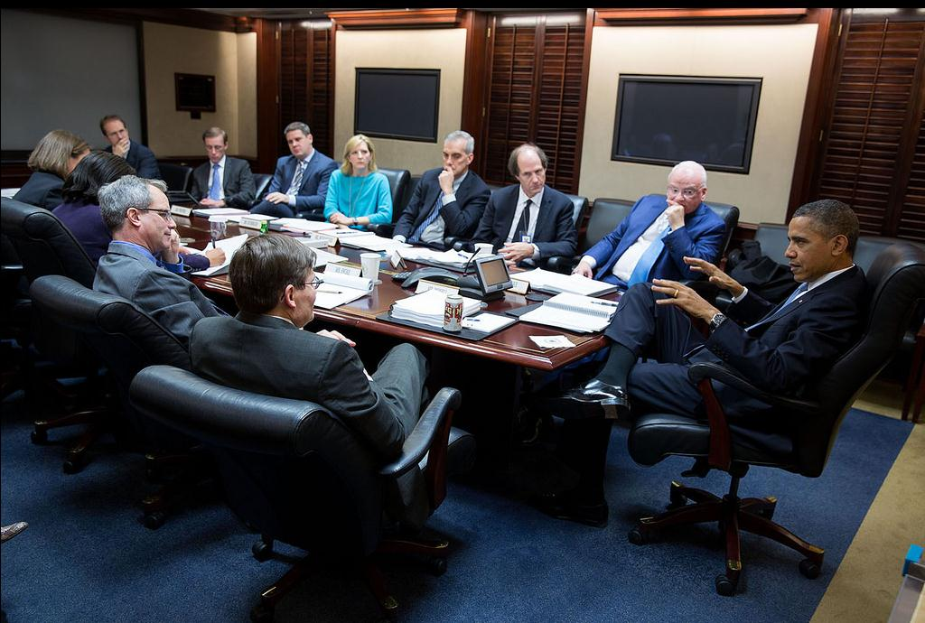
December 2013: The Situation Room

Slide 5
Our assigned task
Protect national security
Advance our foreign policy, including economic effects
Protect privacy and civil liberties
Maintain the public trust
Reduce the risk of unauthorized disclosure

Slide 6
Our Report
Meetings, briefings, public comments
300+ pages in December
46 recommendations
Section 215 database “not essential” to stopping any attack; recommend government not hold phone records
Pres. Obama speech January
Adopt 70% in letter or spirit
Additional recommendations under study

Slide 7
Our Report
Meetings, briefings, public comments
300+ pages in December
46 recommendations
Section 215 database “not essential” to stopping any attack; recommend government not hold phone records
Pres. Obama speech January
Adopt 70% in letter or spirit
Additional recommendations under study

Slide 8
The Declining Half Life of Secrets
The IC assumption was that secrets lasted a long time, such as 25-50 years
My descriptive claim – the half life of secrets is declining sharply
Multiple information-based trends lead to this

Slide 9
Data Quantity & Dissemination
How much can an insider leak?
A lot. One thumb drive can ruin your whole day.
One CIO: “My goal is that leaks happen only by a printer”
How well can an insider disseminate secrets?
Old days: Ellsberg needed the NY Times
Today: Wikileaks, no gatekeeper to the Internet

Slide 10
Mosaic Theory as Risk to the IC
The mosaic theory historically used by the IC
Now, it turns against the IC
Bigger effort to publicly reveal IC activities
More sensors in private hands, networked
Crowd-sourcing – once some data is revealed, the world collaborates to put the pieces together
E.g., Paglan & spy on the spy satellites

Slide 11
Threat to IC from IT Sociology
Contrast of USG & Silicon Valley view of Snowden on traitor v. whistleblower
USG: with all the briefings, I have not yet found an IC person who says WB
Silicon Valley: In one company, over 90% say WB
“Thunderous applause” for Snowden at SXSW
Schneier: the civil disobedience of this generation
Sociological chasm between left coast/right coast or Cambridge/Oxford
Solution: IC shouldn’t hire any techies? EFF membership as disqualification for security clearance?
Those aren’t good counter-measures

Slide 12
Sources & Methods of SigInt
Before:
Often-separate & “foreign” communications
Listening Posts
Monopoly PTTs work closely with government
Now:
Convergence of hardware, software, networks
IC efforts to intrude, but intrusion detection
Many comms thru new players with no former cops
Risk higher than before that someone outside of the IC will detect intrusions/year and report that

Slide 13
Policy Implications of Declining Half Life of Secrets
Previously, the IC often ignored the “front page test”
Jack Nicholson & “you can’t handle the truth” in A Few Good Men
But, how many front page stories this year?
Apply front page test ex ante:
At time of initial decision, higher expected value of revelations – bigger negative effect if ignore the front page test; Merkel is still in office
RG: effects on foreign affairs, economics, Internet governance, so USG must consider these multiple effects and not isolate IC decisions

Slide 14
Finally
12-step program needed for agencies used to secrets
From denial to acceptance
A painful process
Begins by accepting the need to change

