Slide 1
Scheller Distinguished Speaker Series: Cybersecurity, Data Localization, and Choosing Your Research
Peter Swire
Scheller College of Business
School of Cybersecurity & Privacy
December 2, 2021
Notes:
Thank you Mark for that kind invitation. I am happy to be here today. My aspiration is to be a transformative and enabling school chair for SCP

Slide 2
Overview
“The effects of cybersecurity on data localization”
Roll-out to different audiences
Choosing a research topic
A bit of my background
An opportunity for Scheller, teaming with the new GT School of Cybersecurity and Privacy

Slide 3
Why EU Privacy Law is Relevant to Data Localization
Ban on transfers of personal data from EU to US and other countries unless they provide “adequate” protection
If the country isn’t “adequate”
Limited exceptions to transfer data
Court struck down EU/US Safe Harbor (2015) and EU/US Privacy Shield (July 2020) in Schrems II case
Court cast doubt on standard contract clauses
Bottom line – not clear whether any lawful basis for many transfers from EU to rest of world

Slide 4
China and India
China
National security concerns if data of Chinese nationals goes to other countries
2018 – localization for transfers in critical infrastructure industries
Now – broader localization proposals and rules
India
2020: localization for financial transactions
Its Supreme Court said India must pass a national privacy law
Legislation may pass soon
Legislation has broad rules requiring “hard” localization – transfers not permitted

Slide 5
From Globalization to Localization
How does globalization look if you remove EU, India, and China?
National security and “data sovereignty”
Would U.S. persons want their sensitive data to go to Russia, etc.?
Localization has been supported as a way to improve security
National security – keep the data local
Privacy – keep the data secure in EU/India where it’s safe
Our paper:
Localization poses large risks to cybersecurity

Slide 6
Our research included
Literature review – no previous systematic discussion
Interviews with industry experts
Reviewed 200+ comments to EU that expressed concerns about limits on transfers after Schrems II case
Over a year spent trying to explain it systematically and clearly

Slide 7
Categorizing the Effects of Data Localization on Cybersecurity
Risks to integrated management of cybersecurity risk
Limits provision of cybersecurity-related services to third parties (pay)
Limits information sharing to third parties to help cybersecurity (free)

Slide 8
Integrated Risk Management
ISO 27002 has 14 types of cybersecurity controls
13 of them are disrupted by data localization
Asset management, access controls, systems acquisitions, audit, etc.
Effects of localization include:
Managers lose the big picture
Complexity reduces cybersecurity
Less efficient division of labor

Slide 9
Third-party cybersecurity services
$200 billion/year market for these services
Cloud, and limited expertise in-house
Localization limits access to the state of the art
Purchasers of the state of the art are better protected
Makes EU or India the target, when they use worse services
In the name of protecting data, result is weakening protection

Slide 10
Information sharing and cybersecurity
Defenders collaborate, and share information about attacks
IP addresses that are malicious, can’t send from EU and India
Effects could include
Can’t investigate cyber-crimes (no data sharing)
Disrupts forensics of data breaches/exfiltration
Weakens anti-fraud efforts

Slide 11
Conclusions of the Paper
Localization done in the name of security often will undermine security
Proponents of localization must address this
Localization proposals, at a minimum, should address the new risks and consider exceptions
Every professor’s favorite – this will need a lot more study

Slide 12
Outlets for a paper: Reach Multiple Audiences
Academic main paper: submitted to Oxford U. Press “Journal of Cybersecurity”
Free version then at SSRN (41 pages, including ISO appendix)
Roll-out: Politico EU, news
“Privacy law is supposed to protect data, but it is being used to undermine cybersecurity, and thus undermine data protection”
Computer scientists – “this is a big problem”
Communications of the ACM (4 pages)
Policy community: Lawfare/Cross-Border Data Forum (1000 words)

Slide 13
Thoughts on a Research Career
What do you like to do?
What are you good at?
What is your comparative advantage?
Junior faculty – state-of-the-art on techniques and literatures
Senior faculty – spot the important, unexamined topic
Why is this topic worth doing?

Slide 14
Why this paper topic?
Something changes, what consequences?
EU and India
Reasons topic has been unexamined
EU emphasis on fundamental rights
Decision of European Court of Justice
Focus on risks of transfer of personal data to US
Hesitancy to criticize the Court, and GDPR, and fundamental rights
Size of the market: $200 billion/year
An intellectual puzzle – took a year of research to make it simple
Opportunity for impact – policy can still improve cybersecurity
We were in a good position to lead on this topic - interviews

Slide 15
My Background

Slide 16
Raised in Albany, NY

Slide 17
My family

Slide 18
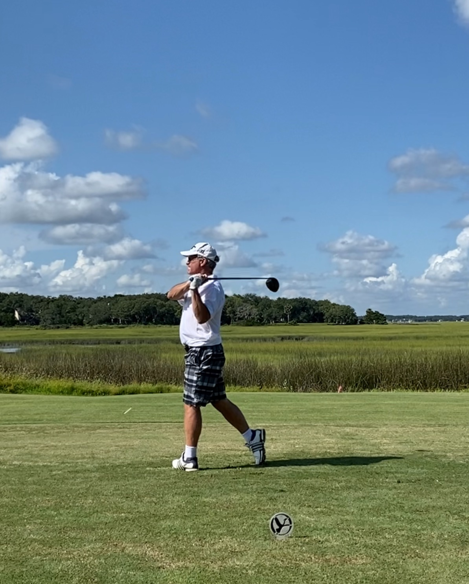
In my free time ….
Cut board game
And TFK?

Slide 19
Education

Slide 20
Lifelong Love of Computing/Cyber/Privacy
Undergrad at Princeton:
The Onslaught of Complexity: Information Technologies and Their Effects on Legal and Economic Thought.
Peter Swire
Notes:
Image from: https://assets-global.website-files.com/5b6df8bb681f89c158b48f6b/5d1dc871cff6e0bdde005598_Image-2.jpg

Slide 21
Law Professor, 1990-2013 (except for White House leaves)
Taught 17 Different Courses in Law Schools:
Wide-ranging intellectual interests
Taught whatever the School Needed
Privacy Law (1997-)
Law of Cybersecurity (2003-)

Slide 22
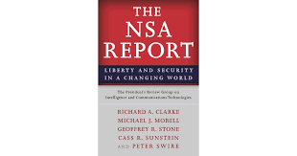
Government Service
Chief Counselor for Privacy, 1999-2001
Special Asst. to President Obama for Economic Policy, 2009-2010
NSA Review Group, 2013
Forum on Cyber Resilience, 2015-21
Future of Encryption, 2020-

Slide 23
Georgia Tech, 2013 - present
MGMT 4725/6725: Information Security Strategies and Policy (this spring)
MGMT 4726/6726: Privacy Technology, Policy, and Law (Anton)
MGMT 6727: Privacy for Professionals (online – with Kennedy-Mayo)
Scheller service includes Co-Chair Strategic Planning Committee

Slide 24
Industry Advisory Boards
Notes:
Kabir

Slide 25
Non-Profit Leadership
U.S. CLOUD Act (2018) adopted our proposal
Founder & Research Director (2018-)
Academic Fellows
Corporate Memberships
Notes:
If chair, not clear

Slide 26
An opportunity for Scheller to team with SCP
GT School of Cybersecurity and Privacy created fall 2020
Currently in 1st year of full operation, under interim chair
I have a joint appointment
Also, I am one of four finalists for chair – I have no clue who will be chair
Whatever happens with chair search, I believe there is a significant opportunity for Scheller

Slide 27
SCP Mission
“Cybersecurity includes not only technology, but the law, business processes, and cultural considerations. The School of Cybersecurity and Privacy will bring together thought leaders from all of those areas to push the envelope of technical innovation and produce the workforce of the future.”
- Dean Charles Isbell

Slide 28
Balance Across Disciplines

Slide 29
ABET Accreditation Curriculum Requirements: Current Composition of SCP Faculty
Notes:
Component Security -- testing analysis
Connection Security – connections between components

Slide 30
Notice “organizational security” and management/”human security”

Slide 31
Organizational Security
SCP currently has no faculty who focus on “organizational security”
Organizational Security: “protecting organizations from cybersecurity threats and managing risk to support successful accomplishment of the organizations’ missions.”
Annual market for cybersecurity services ~ $200 billion

Slide 32
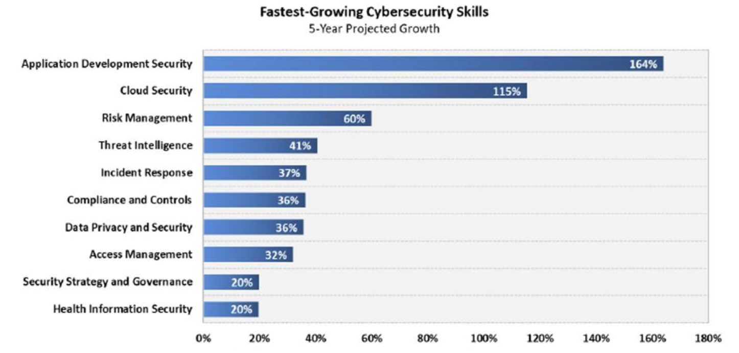
Notice “risk management”, plus incident response, compliance, governance
Notes:
Image Source: https://www.forbes.com/sites/louiscolumbus/2020/11/01/what-are-the-fastest-growing-cybersecurity-skills-in-2021/?sh=3c7eea895d73

Slide 33
Idea: Cluster Hire in Organizational Security
Support on the Hill for the new School
Last year six new tenure-track hires
Goal to hire at least that many this year
Should fill in the current gaps, and strategy for that can be a “cluster hire” of 3+ new faculty
Can be business faculty 100% in SCP, or joint appointments with Scheller
In sum - a way to get new business faculty “lines” during a time of budget constraints

Slide 34
Teaming Scheller and SCP: Research
Research funding
In general, NSF and other funding more available to computing faculty in cybersecurity than to business professors
Trend toward multi-disciplinary teams
E.g., team organizational and technical expertise
Many great research topics, due to market and technical changes
One possibility – this funding can support faculty summer salaries
One example: supply chain as critical cyber risk
SolarWinds – attack through a software security provider
Now, huge focus on managing the supply chain
To date, attention from technical experts looking at technical risks
International trade expertise is needed, and management/strategic expertise
A good research topic for business faculty

Slide 35
Teaming Scheller and SCP: Executive Education
Boards of Directors – increasingly seek a cyber-trained Director
General managers, at senior levels – increasingly, need to learn to manage a major risk – cybersecurity
Outstanding GT reputation in technical cybersecurity is a selling point for managing the business aspects as well
Fits with current Scheller push for certificates and other shorter-term and/or online learning
Scheller can also help offer company-specific programs

Slide 36
Conclusion: Who and How to do Organizational Security?
For SCP to succeed, it will need to be excellent on organizational security issues
Consider the best ways to team together to make that happen

Slide 37
Thank you
Discussion and Questions?
Data localization
How to select a research project
School of Cybersecurity and Privacy

