Slide 1

“The Non-Code Layers of the Cyberstack - Lessons for Cybersecurity”
Peter Swire
Scheller College of Business
Faculty Workshop
December 7, 2017

Slide 2
The Challenge
Cybersecurity management, law, and policy have a confusing, overwhelming jumble of issues to cover
  How can we teach that jumble?
  Is there a way to organize the material to bring clarity to the field?
  Can that lead to better responses to overall cybersecurity threats?
“Real” cybersecurity
  “Real” cybersecurity is about writing code and doing technical work
  The “soft” issues have not been central to the task of “real” cybersecurity
  Vague approval of “inter-disciplinary” studies for cybersecurity
    But, with a lower priority than “real” cybersecurity

Slide 3
Project on Non-Code Aspects of Cybersecurity
This project proposes a new conceptual framework
Organizes numerous, important, & non-technical cyber-issues
Presents the curriculum and issues in ways that make sense to both technical and non-technical audiences in cybersecurity

Slide 4
The Genesis of this Project
MGMT/CoC/PubPol 4726/6726 “Information Security Strategies and Policy”
  This is my fourth time teaching the course, now required for Masters in Information Security, and credit for ITM and law for undergraduates
  How do all the pieces of this course fit together? There seems to be something coherent, but it’s been very hard to describe
  This fall – 3 parts of the course
    Government laws/regulations – project on proposed legislation for cybersecurity and Internet of Things
    Corporate cybersecurity policies and governance – draft ransomware policy for a hospital group
    Nation state and international – draft National Security Council memo on cyberthreats from Russia and policy options to respond
  My answer now: 3 layers of the cyber stack – organizational, governmental, international

Slide 6
Seven Layers of the OSI “Stack”
In my experience, these seven layers are well known to knowledgeable
computer people who work on cybersecurity. Intuitively, they also know
that cyber-attacks can happen at any of these 7 levels.

Slide 7
Some Cyber Vulnerabilities
Layer | Vulnerability
1. Physical | Cut the wire; stress equipment; wiretap
2. Data link | Add noise or delay (threatens availability)
3. Network | DNS and BGP attacks, false certificates
4. Transport | Man in the middle
5. Session | Session splicing (Firesheep); MS SMB
6. Presentation | Attacks on encryption; ASN-1 parser attack
7. Application | Malware; manual exploitation of vulnerabilities; SQL injection; buffer overflow
Thanks to Bob Blakely for assistance with this material.

Slide 8
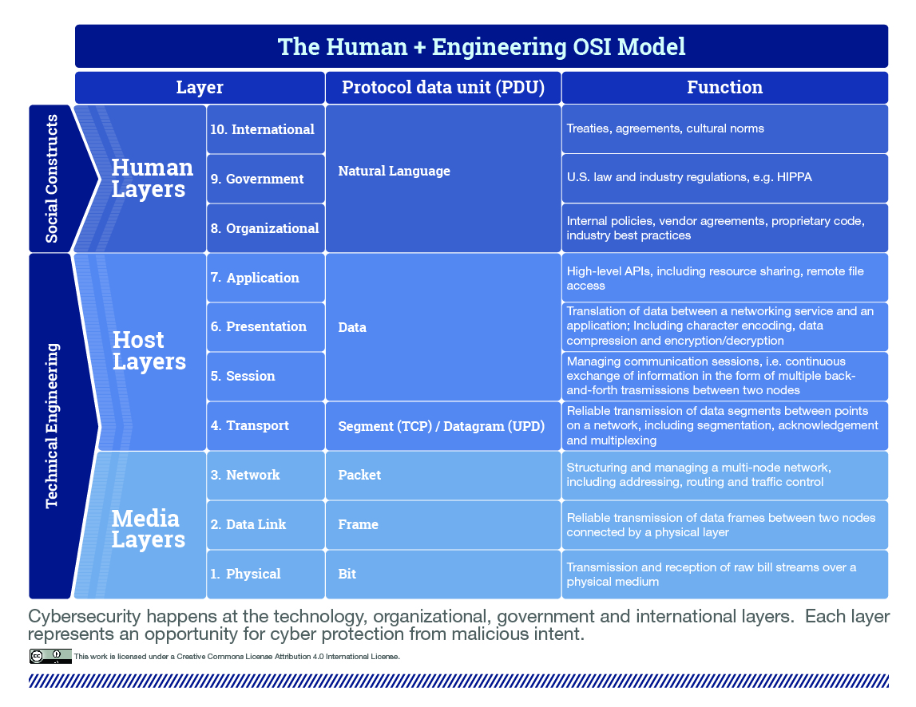
What is Missing from the 7 Layer OSI Model?

Slide 9
Layers 8, 9, and 10: Natural Language
Layer 10 | International | Natural language | Diplomacy
Layer 9 | Governmental | Natural language | Law
Layer 8 | Organizational | Natural language | Contracts
Layers 1-7 | OSI stack | Computer Code | Various protocols

Slide 10
Layer 8: Private-Sector Organizations: Role of Contracts
 | Within the Organization | Relations with Other Actors | Other Limits on Private Sector
Examples of cyber law and policy | Incident response plans & other internal policies Training Cyber hygiene Roles, such as CISO Users’ precautions | Vendor & other contracts & management Cyber-insurance Private-sector information sharing (ISACs) | PCI-DSS and other industry standards Technical standards such as IETF Norms – follow the standards

Slide 11
Layer 9: Public Sector, Governmental Layer: The Law
 | Within the Organization | Relations with Other Actors | Limits on Government
Examples of cyber law and policy | HIPAA, GLBA, and other cyber rules Other state-created defensive measures (FTC Sec. 5, etc.) Rules limiting strong encryption | Computer Fraud & Abuse Act and other limits on offense CISPA and public-private partnerships and information sharing | Constitutional limits on state action, such as 4th Amendment Statutory limits on state action, such as ECPA and FISA

Slide 12
Layer 10: International Layer: Diplomacy
 | Within the Nation | Relations with Other Nations | Other Limits on Nations
Examples of cyber law and policy | Unilateral cyber actions, on spectrum from war to “cyber-peace” Deterrence against aggressive cyberattacks | Formal treaties, including MLATs Less formal agreements, such as US/China trade secrets Cooperation with other nations on attacks and defense | Possible supra-national governance, such as by UN or ITU Role of international law, including laws of war ISO standards and norms

Slide 13
Where do Users fit?
A user is not a government or an international actor
I suggest part of Layer 8
  Could be called “private sector” instead of “organizational” layer
  Private sector actors range from individual users/sole proprietorship to modest size to large organizations
Users lack an IT department, a general counsel, and face lots of risks
8A: “Within the household” – how individual/family manages
8B: “Relations with other actors” – Terms of service, insurance, hire Geek Squad
Users likely a big concern at 9A (government regulation of business), such as HIPAA, GLBA, and consumer protection

Slide 14
The 3x3 Matrix of Cells
Distinctions are good but not perfect:
  Public vs. private, and protecting a government agency much like protecting a corporation
  Within and outside of the organization – gray areas, such as whether relations with a parent/affiliate are inside or outside of the organization
  My hope – readers can generally agree which problems go in which of the 3x3 cells; if so, then a useful framework for categorizing

Slide 15
Separation of Layers
Tech friends comment that there is supposed to be a clear separation of layers of the stack; concern is that this doesn’t exist at the non-code layers
  That’s true; the “protocol” for layers 8, 9, & 10 is “natural language (English, etc.), so the separation not the same as lower levels of the stack
  For instance, users agree to TOS with vendors (8B) but subject to government rules (9A or 9B)
  In response, can usefully analyze the TOS, and can also usefully analyze the quality of the legal rule

Slide 16
Potential for the Cyber Curriculum
Helps describe what topics are done in which course:
  Mostly international relations and cyber norms, and course covers 10A, 10B, and 10C, with some layer 9
  Mostly corporate governance for CISOs, lots of 8A and 8B, with a little bit of the others
  An overall curriculum could determine how full the coverage is of the 3x3 matrix
Can also shift from a project course (reacting to new developments) to a lecture course or treatise/manual :
  Module on each cell of the 3x3 matrix, with typical vulnerability and governance issues for each cell
  For instance, 9A and compare market approaches to HIPAA or GLBA; if govern badly, then sensitive data is breached

Slide 17
Contributions of the 10-layer stack
Parsimonious structure to organize the jumble of issues now crowding into cyber law, policy, and business courses
  This fall, we discussed every issue in 3 charts in my cyber course
  For students and teachers, a way to keep the many issues straight
Attacks can happen at layers 8, 9, and 10, if the company has bad policies, the nation has bad laws, or the international community does not prevent attacks
  Vulnerabilities at layers 8, 9, and 10 thus fundamentally similar to vulnerabilities at layers 1 to 7
  Computing & business students, by end of the course, agreed that a large part of the current cyber threat is at these layers

Slide 18
The Project
Presented this at Stanford this fall to other professors designing cyber law/policy/management courses
Complete the text and diagrams for the 10 layers of the cyber-stack – I welcome your comments and suggestions
Consider whether to write the manual/treatise for the 3x3 matrix
Hopefully, bring a sense of order and understanding to the current jumble
  Which, in turn, would lead to better cybersecurity

